Slide 1
Advanced Heterocyclic Chemistry
By: Hossein Tavakol
Week 1-86 slide

Slide 2
References:
Comprehensive Heterocyclic Chemistry: A. R. Katritzky
Handbook of Heterocyclic Chem : A. R. Katritzky
Heterocyclic Chemistry: T. L. Gilchrist
Paquette
Heterocyclic Chemistry: J. A. Joule and K. Mills
The Chemistry of Heterocycles: T. Eicher, S. Hauptmann

Slide 3
There is three systems for heterocycle’s names:
Trivial names
Generic names, and Trade names (for drugs and natural products)
Replacement system (for ring with more than ten)
IUPAC (Hantzsch-Widman) names (up to ten)

Slide 4
Trivial and Generic names
These name are acceptable in many cases and used in the nomenclature of systematic fused rings

Slide 5
More exapmles

Slide 6
Replacement system:
Based on the replacement of heteroatoms prefix on hydrocarbon’s name (aromatic or non-aromatic)
As all prefixes end with the letter a, replacement nomenclature is also known as 'a' nomenclature. Position and prefix for each heteroatom are written in front of the name of the corresponding hydrocarbon. This is derived from the heterocyclic system by replacing every heteroatom by CH2, CH or C

Slide 8
Numbering system (in all systems)
Rules:
In HC with one heteroatom: heteroatom has number 1 except in fused ring like Isoquinoline (later will be discussed)
Cycles containing more than one different heteroatoms the numbering begins at the atoms of the higher order of priority (shown in table I) and proceeds round the ring in order to give other heteroatoms the least possible numbers without regards to the substituents

Slide 9
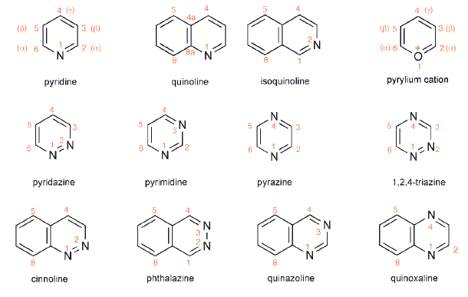

Slide 11
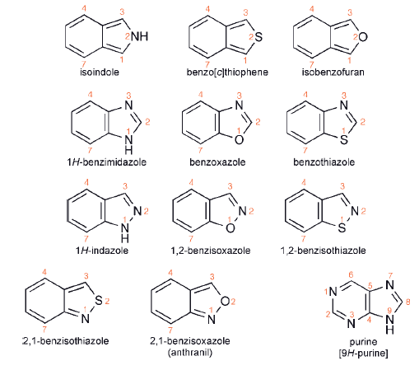

Slide 12
Hantzsch-Widman system

Slide 13
Prefix:
It indicates the type of the heteroatom, their numbers and their positions. (Table I):
When two or more heteroatom of same type are present, the prefix di, tri,...etc. is used.
If the heteroatoms are different, their order of citation start with the heteroatomof as high a group in the periodic table and as low an atomic number in thatgroup. Thus the order of naming will be: O > S > Se >N >P > Si > B > Hg etc.

Slide 14
Table 1: The prefixes

Slide 15
The Stem and Suffix
The stem determines the ring-size from 3 membered ring to 10 membered ring. The source of stem raised to numbers: 3 (three): ir
The suffix determines the state of saturation or unsaturation which depends upon the presence or absence of N and the ring size

Slide 16
Table 2: Stems and Suffixes

Slide 17
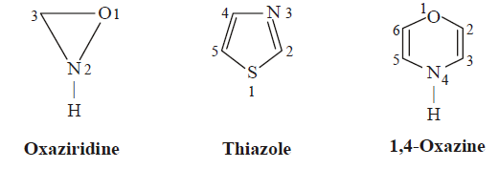
Samples

Slide 18
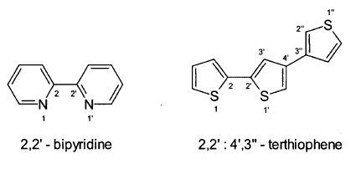
Identical systems connected by a single bond
Such compounds are defined by the prefixes bi-, tert-, quater-, etc., according to the number of systems, and the bonding is indicated as follows

Slide 19
Partially Saturated Ring
If the number of double bonds is less than the maximum, prefix dihydro tetrahydro,….etc are added to the same name of unsaturated state. The saturated positions are given the least numbers after the hetero atom

Slide 20
Obligatory saturation of a single position(In a heterocyclic ring with maximum unsaturation), if the double bonds can be arranged in more than one way, their positions are specified by numbering those nitrogen or carbon atoms which are not Multiply-bonded, indicated by a symbol 1H, 2H, 3H... etc. according to the position of the saturated atom. The numerals indicate the position of these atoms having the extra hydrogen atom.

Slide 22
The position of the hydrogen atom in a partially saturated heterocyclic ring can be indicated by writing 1, 2-dihydro, etc. Alternatively, the position of the double bond can also be specified as Δ1, Δ2, Δ3.,. etc., which indicates that 1 and 2; 2 and 3; 3 and 4 atoms respectively have a double bond.
In case of 4 & 5 membered rings with partial saturation (i.e) contain only one double bond. The suffix will be (ine) when N is present and (ene) when N is absent, and indicate the position of the double bond over A symbol.

Slide 23
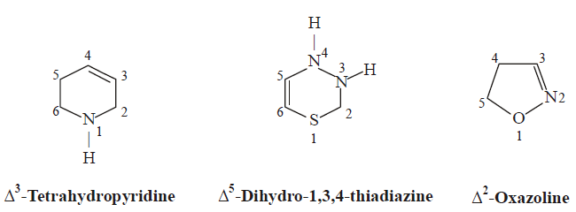

Slide 24
Nomenclature of Fused Heterocycles
Carbocycle fused with heterocyclic system.
The Parent name (written at the end) is the name of the heterocyclic ring.
The fused name (written at first) is the name of the fused benzene called (Benzo).
The Side of fusion of the parent ring with the fused benzene ring is indicated by alphabetical numbering and put such letter (a, b, c, ... etc) between square brackets in between the prefix and parent name. In this case the parent ring is numbered as usual (p 5 ) and the sides 1,2, take letter (a), side 2,3 takesletter (b), side 3, 4 takes letter (c), ... etc

Slide 25
4- The total numbering of the complete fused system in done to determine the positions of saturations or substitutions according to the following rules:
a-The fused system is oriented so that: The greatest number of ring is in a horizontal row, and the remaining rings above the right of this horizontal row.

Slide 26
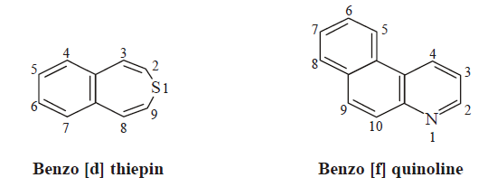
b-The numbering starts from the atom next to the fusion giving the hetero atom the least possible numbering and continue numbering in clockwise direction (whenever possible) and the fused carbons are given the same previous number adding to it letters (a, b, c,etc).
c-In case of poly cycles, the parent name is given to the largest heterocycles containing many rings (provided it has a famous trivial name).

Slide 27
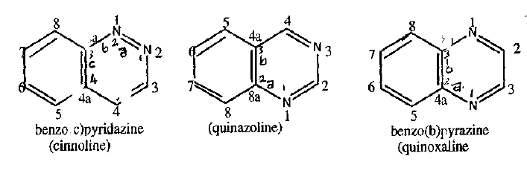
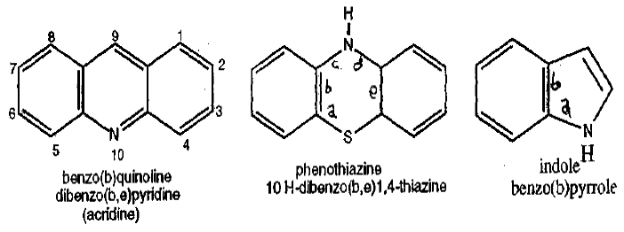

Slide 28
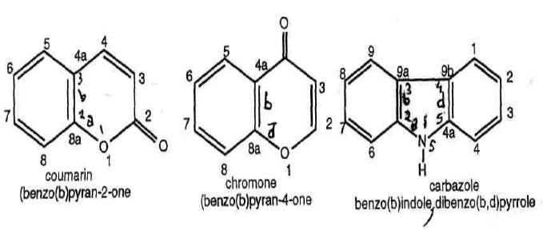

Slide 29
Numbering fused ring
The ring system is projected onto rectangular coordinates in such a way that
as many rings as possible lie in a horizontal row
a maximum number of rings are in the upper right quadrant.
The system thus oriented is then numbered in a clockwise direction commencing with that atom which is not engaged in the ring fusion and is furthest to the left
in the uppermost ring or
in the ring furthest to the right in the upper row.

Slide 30
C-Atoms which belong to more than one ring are omitted. Heteroatoms in such positions are, however, included. If there are several possible orientations in the coordinate system, the one in which the heteroatoms bear the lowest locants is valid.
If the base component does not have a trivial name, the entire system is numbered as explained above and the resulting positions of the heteroatoms are placed before the prefix benzo

Slide 31
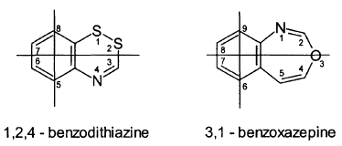

Slide 32
B. Heterocycle fused with another Heterocycles
The IUPAC rules for naming such systems are also composed of 4 points:
The Parent name given to the more prior heterocycle(s), is used as suffix.
The fussed ring (s) name is the less prior rings and is used as prefix.
The side of fusion for both rings.
The numbering of the total system.

Slide 33
Priority rules (in order)
a nitrogen-containing component
a component with a heteroatom, other than nitrogen, which is as high as possible in Table 1
a component with as many rings as possible (e.g. bicyclic condensed systems or polycyclic systems which have trivial names)
the component with the largest ring
the component with most heteroatoms
the component with the largest number of heteroatoms of different kinds
the component with the greatest number of heteroatoms which are highest in Table 1
the component with heteroatoms which have the lowest locant numbers.

Slide 34
The naming of the prefix of fused (less prior) heterocycles is given as such
Furan = furo
Thiophene = thieno
Pyridine = pyrido
Pyrrole = pyrrolo Imidazole = imidazo
Quinoline = quino

Slide 35
I. Determination of the sides of fusion for both sides of the two fused heterocycles as such
A. The side of fusion with the parent ring is numbered alphabetically and the letter of fusion is placed between square brackets at its end.
B. The side of fusion of the prefix ring is indicated by two numbers denoting the two positions of fusion with the parent ring, these twonumbers are also placed at first in the square brackets. The order of writing these two numbers conforms the direction of lettering of the parent ring.

Slide 36
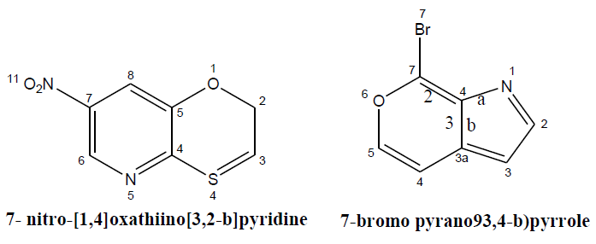

Slide 37
II. The peripheral numbering of the total heterocyclic fused molecule is by the same discussed rule, and considering the following other rules
A) Give the lowest number to the more prior heteroatom (according to table I) especially when present just after fusion. But, if the more prior hetero atom is not the nearest to the fusion side the other nearest heteroatoms after fusion must take the least possible numbering regardless of priority of table I.

Slide 38
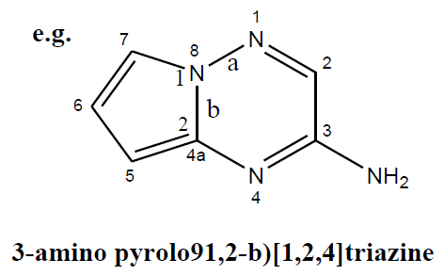
b)The hetero atoms in the fusion side are numbered according to the sequence of numbering, but when carbon atoms in the fusion take the previous number plus letter a, b, c,...etc. and also such carbon atom follow the least possible numbering.

Slide 39
c) The saturated atoms take the least possible numbering before other substitutents

Slide 40
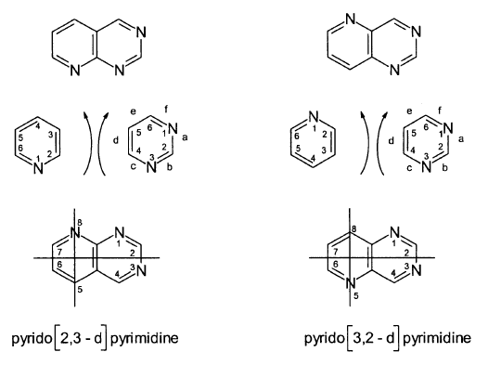

Slide 41
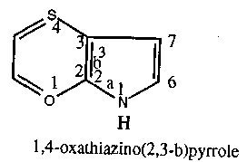
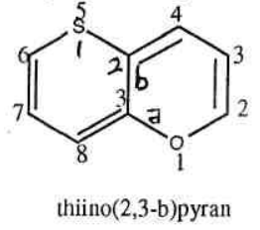
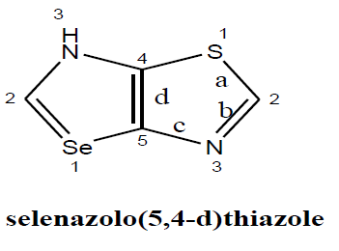
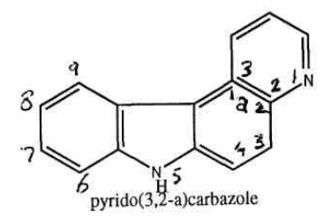

Slide 42
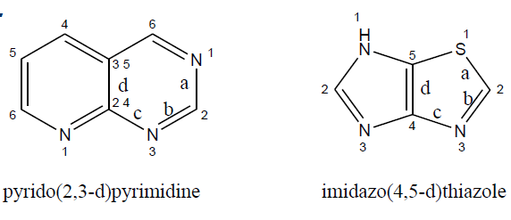
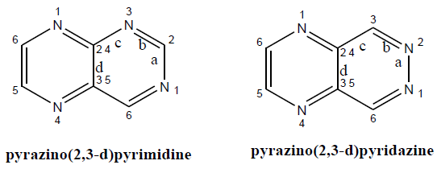

Slide 43
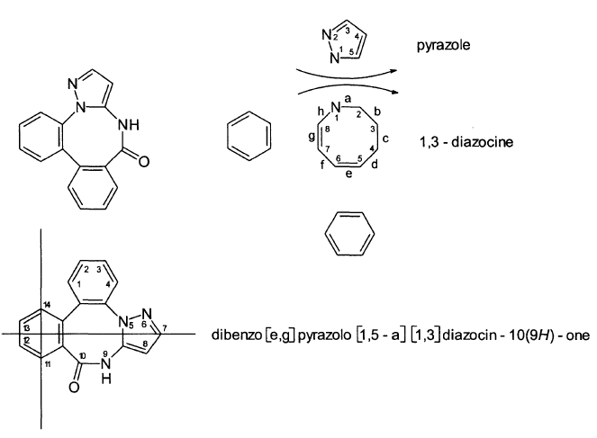

Slide 44
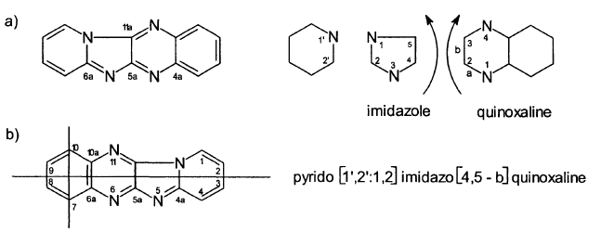

Slide 45
Radicals Derived from Heterocyclic Compounds

