Slide 1
Double Resonance Techniques in NMR
By: Hossein Tavakol

Slide 2
Index
Part A. One-dimensional
Homonuclear decoupling
Heteronuclear decoupling (CPD, Gated,…)
Off-resonance
APT
SPI
DEPT
INEPT

Slide 3
Part B. Two-dimensional (2D)
8. J-Resolved
9. COSY (homonuclear)
10. COSY (heteronuclear)
11. HMQC
12. HSQC
13. HMBC
14. TOCSY (HOHAHA)
15. NOESY, ROESY
16. INADEQUATE

Slide 4
For each method:
A. Definition and obtainable data
B. Pulse sequence
C. Interpretation of spectra

Slide 5
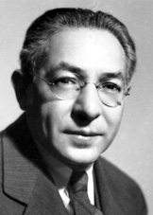
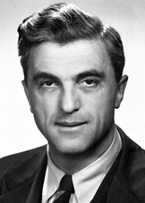
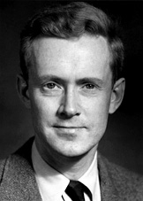
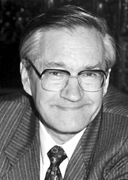
Continuation of NMR History
Nobel prizes
1944 Physics Rabi (Columbia)
1991 Chemistry Ernst (ETH)
1952 Physics Bloch (Stanford), Purcell (Harvard)
"for his resonance method for recording the magnetic properties of atomic nuclei"
"for their development of new methods for nuclear magnetic precision measurements and discoveries in connection therewith"
"for his contributions to the development of the methodology of high resolution nuclear magnetic resonance (NMR) spectroscopy"

Slide 6
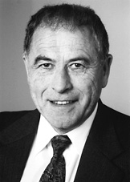
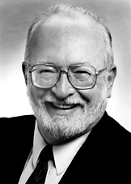
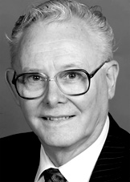
Continuation of NMR History
2002 Chemistry Wüthrich (ETH)
"for his development of nuclear magnetic resonance spectroscopy for determining the three-dimensional structure of biological macromolecules in solution"
2003 Medicine Lauterbur (University of Illinois in Urbana ), Mansfield (University of Nottingham)
"for their discoveries concerning magnetic resonance imaging"

Slide 7
Part A.
One-dimensional
1. Homonuclear decoupling

Slide 8
A. Definition and obtainable data
Used for make the spectra simpler
Deleting solvent signal
B. Pulse sequence
The RF equal to the larmour frequency of the proton employed during the whole of NMR experiment

Slide 9
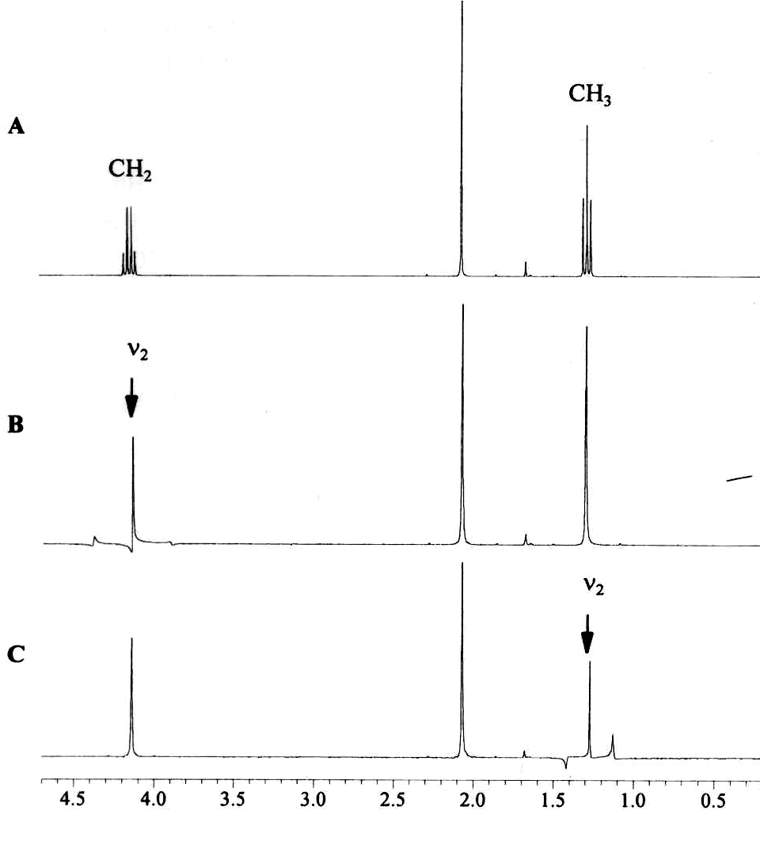
C. Interpretation of spectra

Slide 10
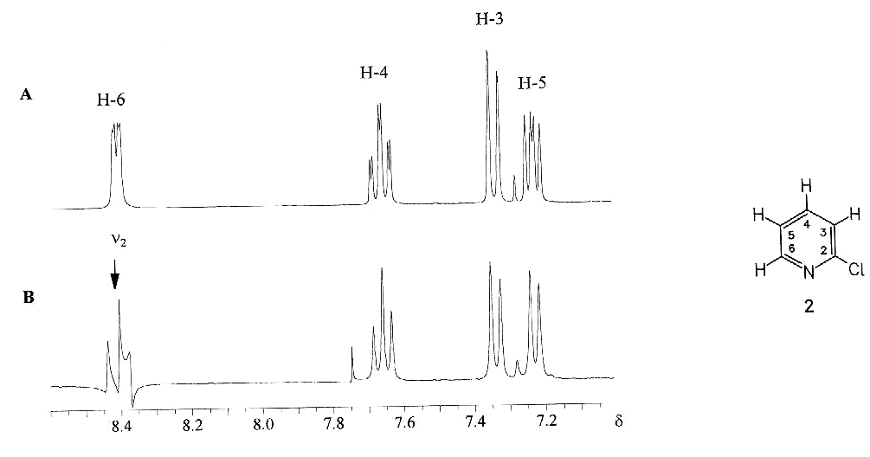

Slide 11
2. HETERonuclear decoupling

Slide 12
A. Definition and obtainable data
Consisted of:
CPD: Carbon proton decoupled or Broad band H decoupling C-NMR
Gated decoupling
Inverse Gated decoupling
All of the above methods have discussed in previous section

Slide 13
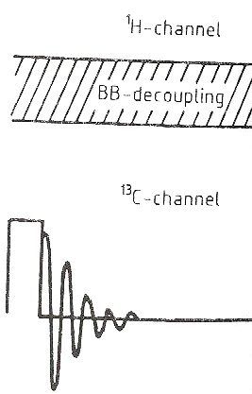
B. Pulse sequence
1. CPD

Slide 14
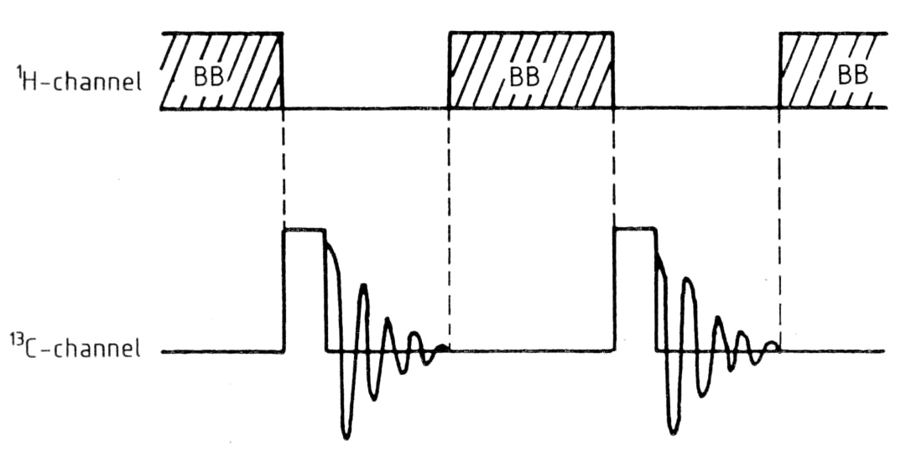
2. Gated

Slide 15
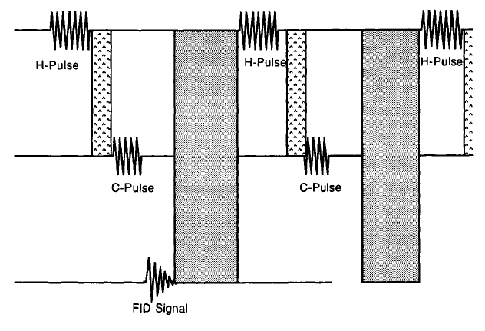

Slide 16
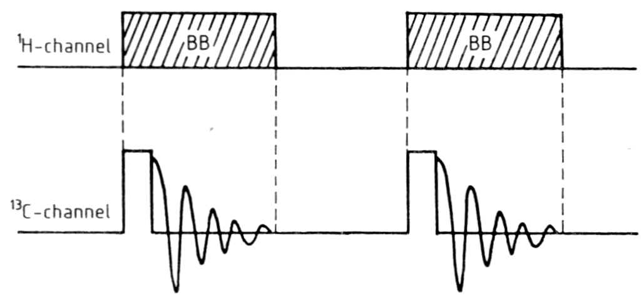
3. Inverse Gated

Slide 17
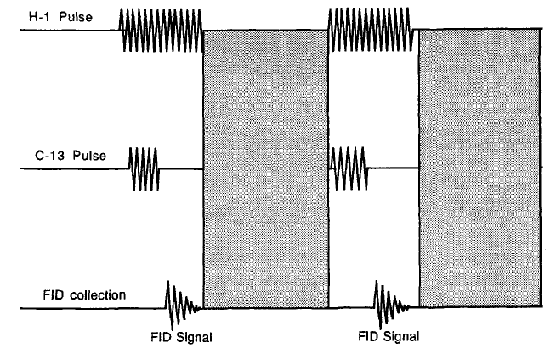

Slide 18
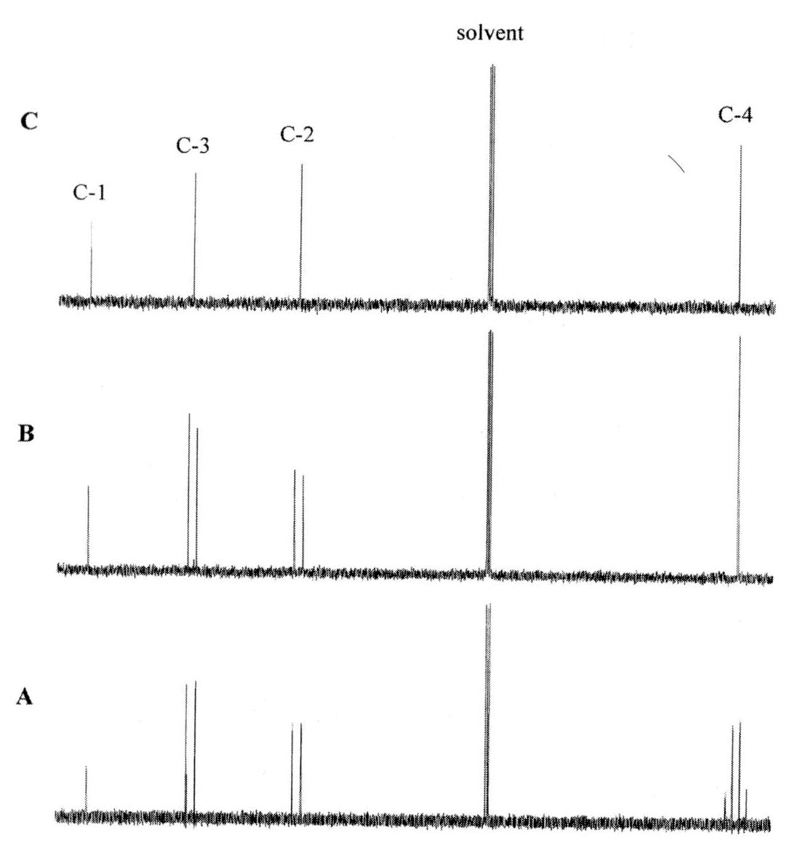
Gated
Selective Me decoupling
CPD

Slide 19
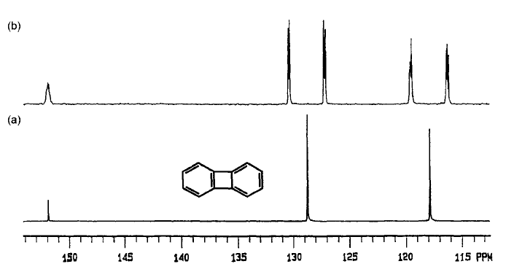

Slide 20
3. Off-resonance

Slide 21

A. Definition and obtainable data
Employing a decoupled signal out of the HNMR spectra
This type of decouplind reduce the JCH but not delete it
Replaced by better techniqes: DEPT, ….
The other name is: SFORD (Single Frequency Off Resonance Decoupling)

Slide 22
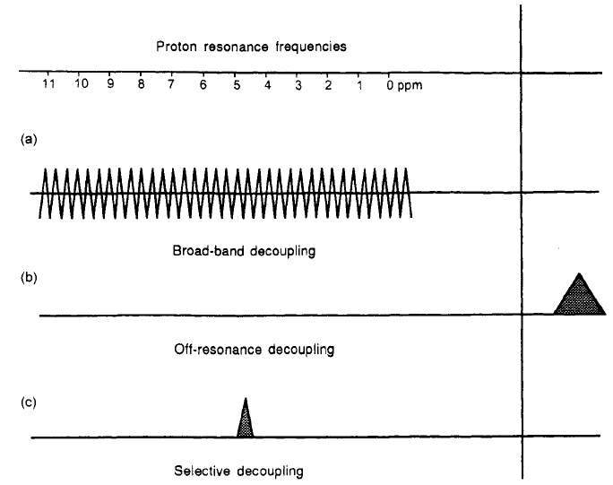
B. Pulse sequence

Slide 23
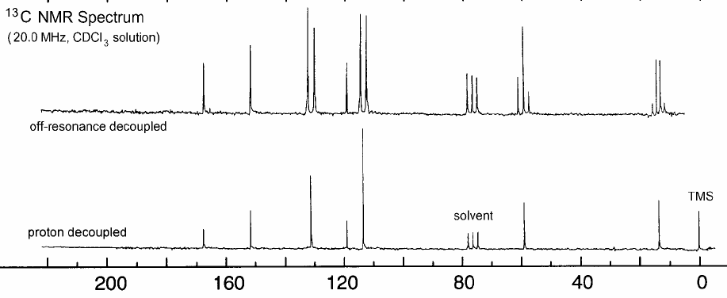
C. Interpretation of spectra

Slide 24
4. APT attached proton test
J-modulated
Spin-echo experiment

Slide 25
A. Definition and obtainable data
Used for determination of number protons attached to the carbon
There are other types of spin-echo experiments like PFG-spin echo
PFG (pulse field gradient) techniques used to obtain high quality spectra

Slide 26
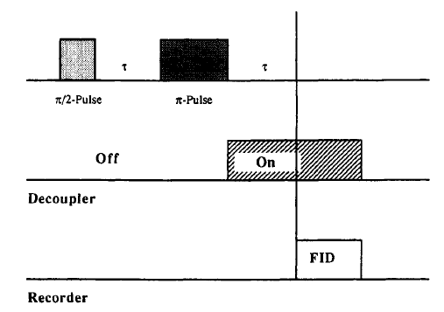
B. Pulse sequence

Slide 27
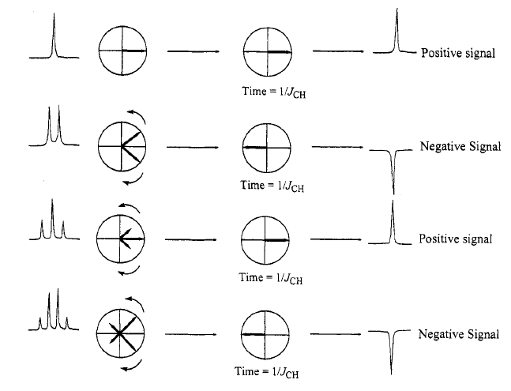

Slide 28
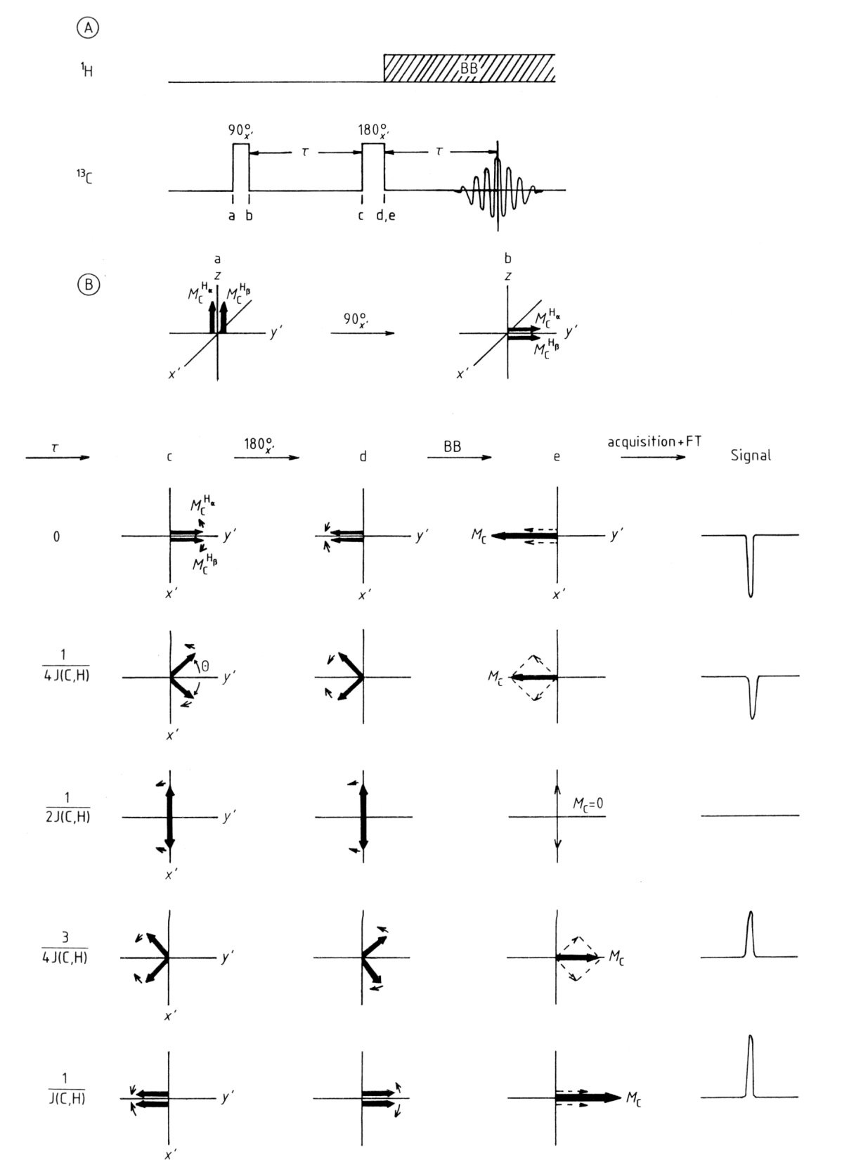

Slide 29
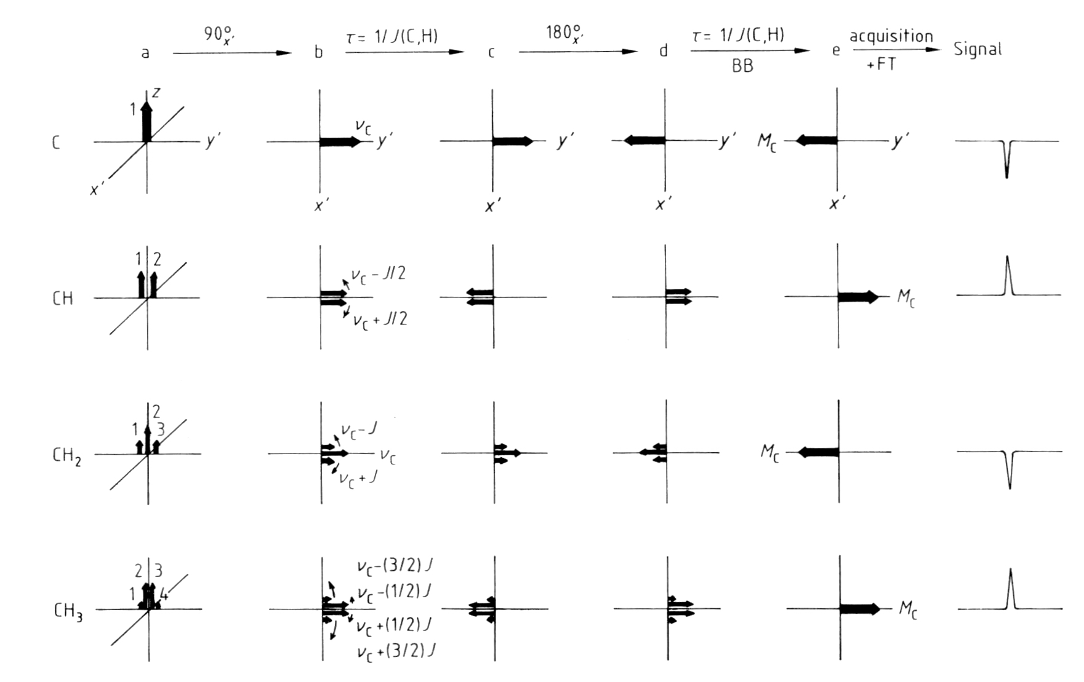

Slide 30
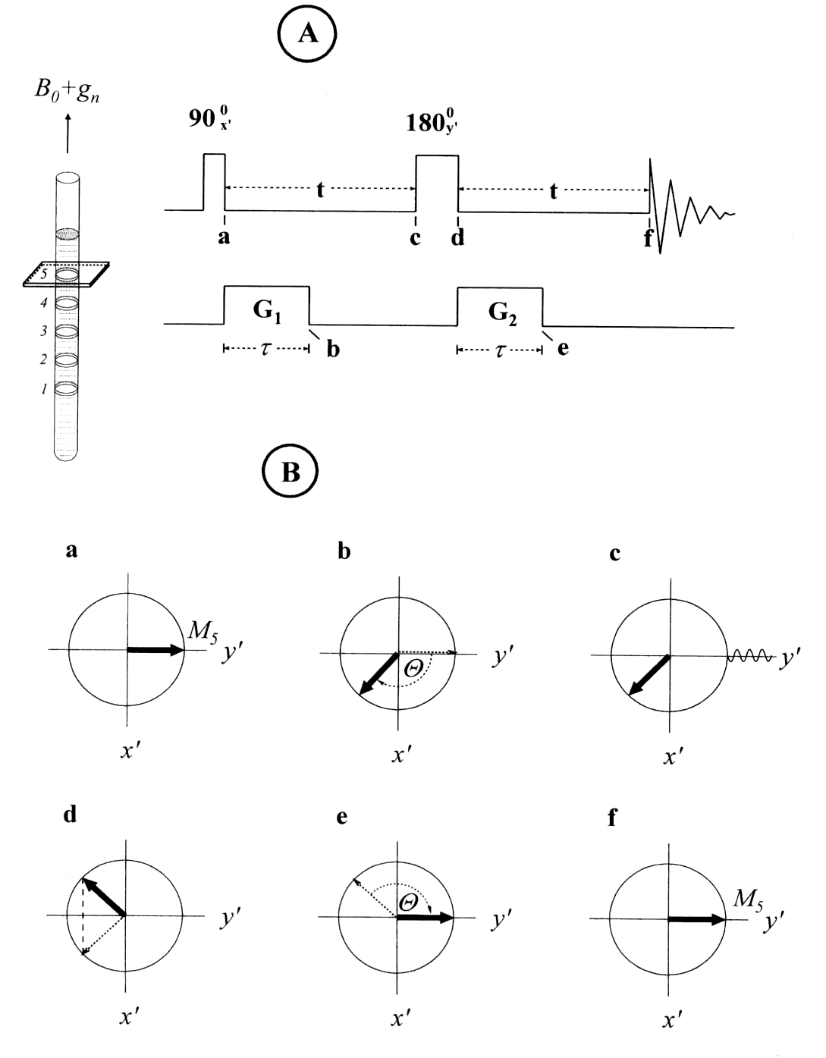
PFG- Spin echo

Slide 31
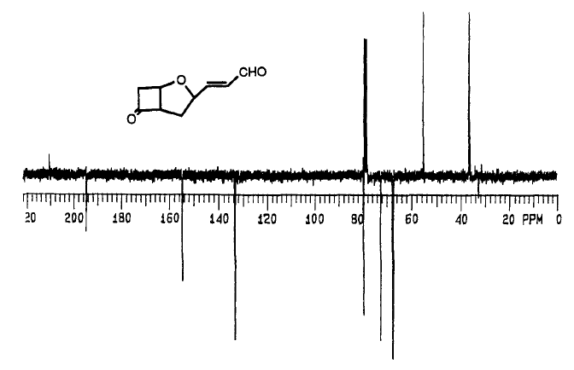
C. Interpretation of spectra

Slide 32
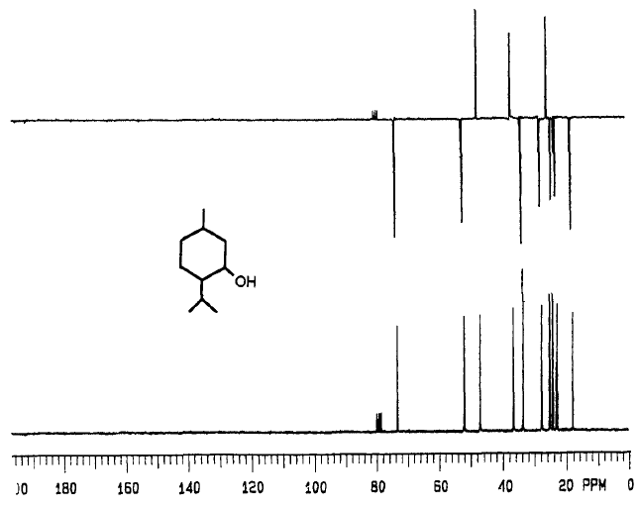

Slide 33
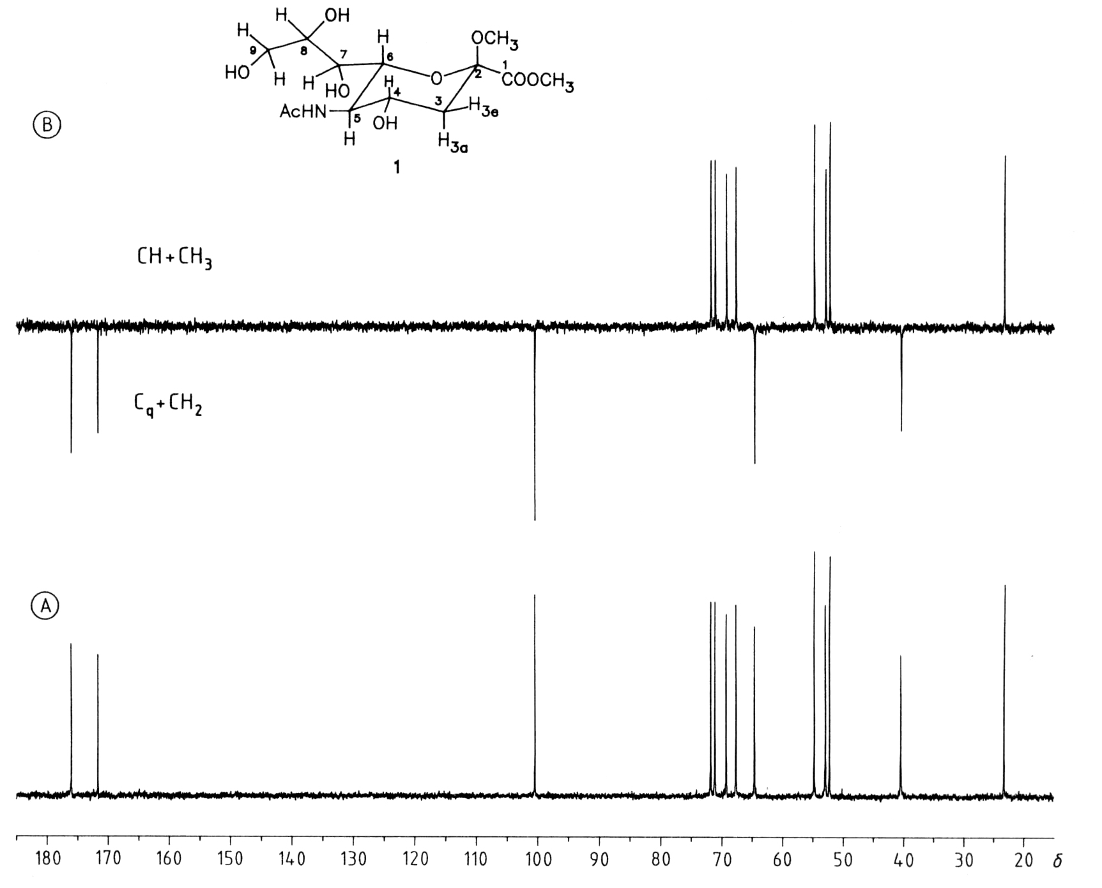

Slide 34
5. SPI selective population inversion
First techniques in:
Signal enhancement by population transfer

Slide 35
A. Definition and obtainable data
It is named also SPT (selective polpulation transfer)
Signal enhancement by population transfer techniques used to enhance the intensity of CNMR spectra
Other types in this category are DEPT, INEPT
Simple SPI is a difficult experiments and other techniques used nowadays
It uses sensitive nuclei (H) and decouple it to enhance the intensity of insensitive nuclei (13C)

Slide 36
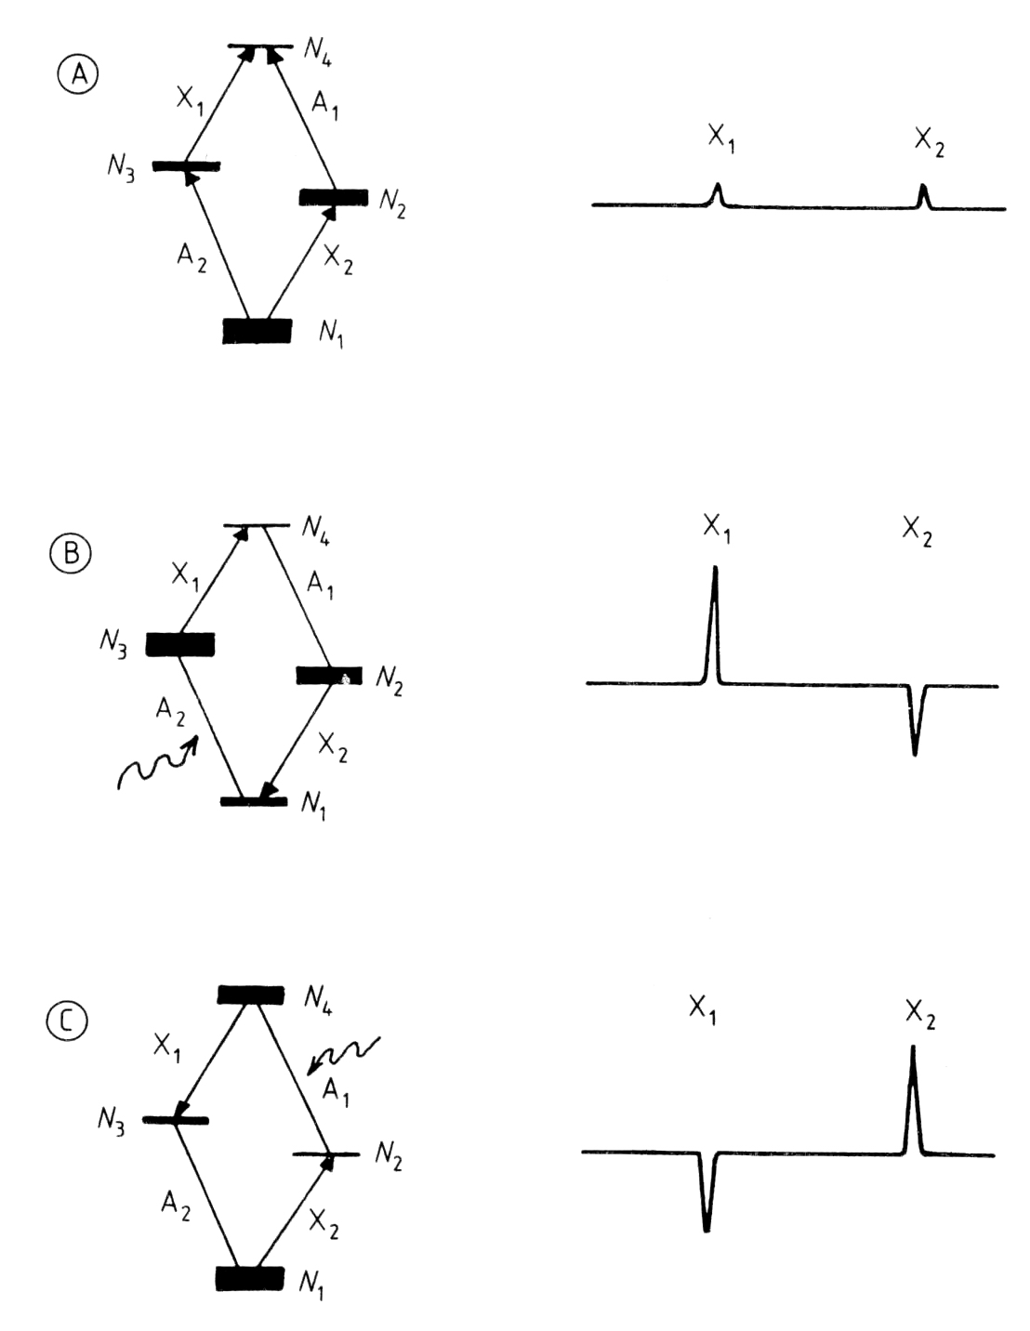

Slide 37
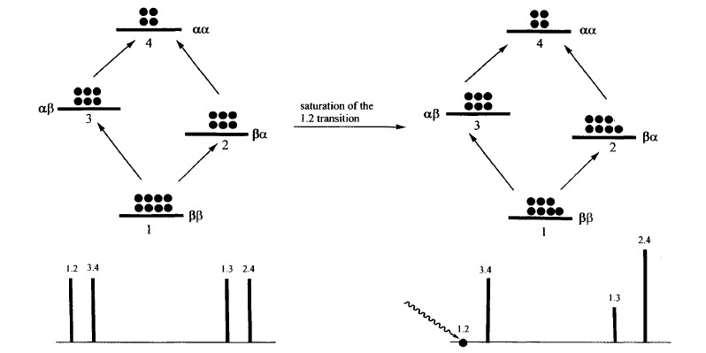
B. Pulse sequence

Slide 38
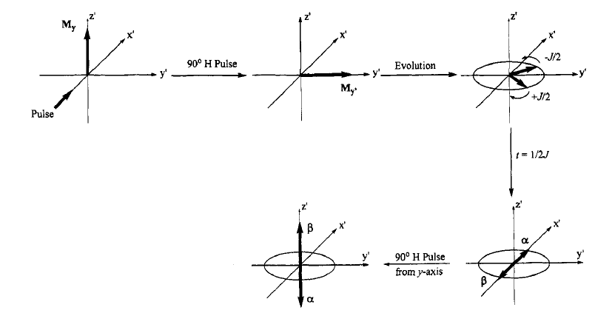

Slide 39
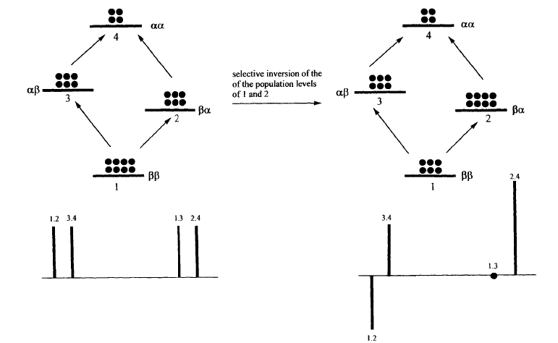

Slide 40
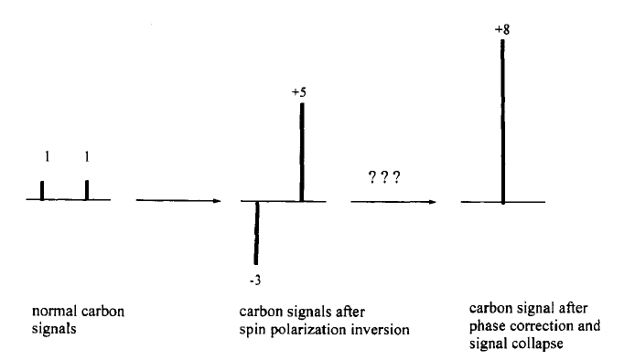

Slide 41
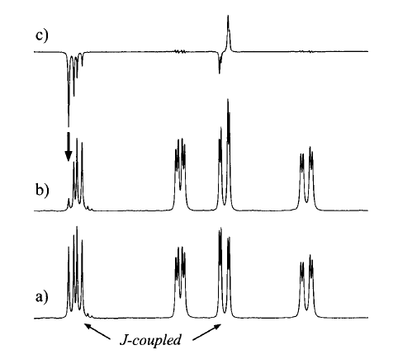
C. Interpretation of spectra

Slide 42
6. DEPT

Slide 43
A. Definition and obtainable data
Distortionless enhancement by polarization transfer
The results are the same as APT with different pulse sequence , it is faster and more sensitive
This technique to distinguish among CH_{3,} CH_{2,} and CH group
DEPT 90: only CH peaks visible?
DEPT 135: -CH₂ peaks negative, -CH and CH₃ peaks positive
PENDANT: -CH₂ and quaternary peaks negative, -CH₃ and CH peaks positive
DEPT ¹³C spectrum does not show a signal for a carbon that is not attached to a hydrogen.
It is now much more widely used than proton coupling to determine the number of hydrogens attached to a carbon.

Slide 44


B. Pulse sequence
1/2J
1/2J
1/2J
CH
CH₃
CH₂

Slide 45
 | C | CH | CH₂ | CH₃
DEPT-135 | 0 | 1 | -1 | 1
DEPT-90 | 0 | 1 | 0 | 0
DEPT-45 | 0 | 1 | 1 | 1
DEPT-Q: DEPT with quaternary carbons

Slide 46
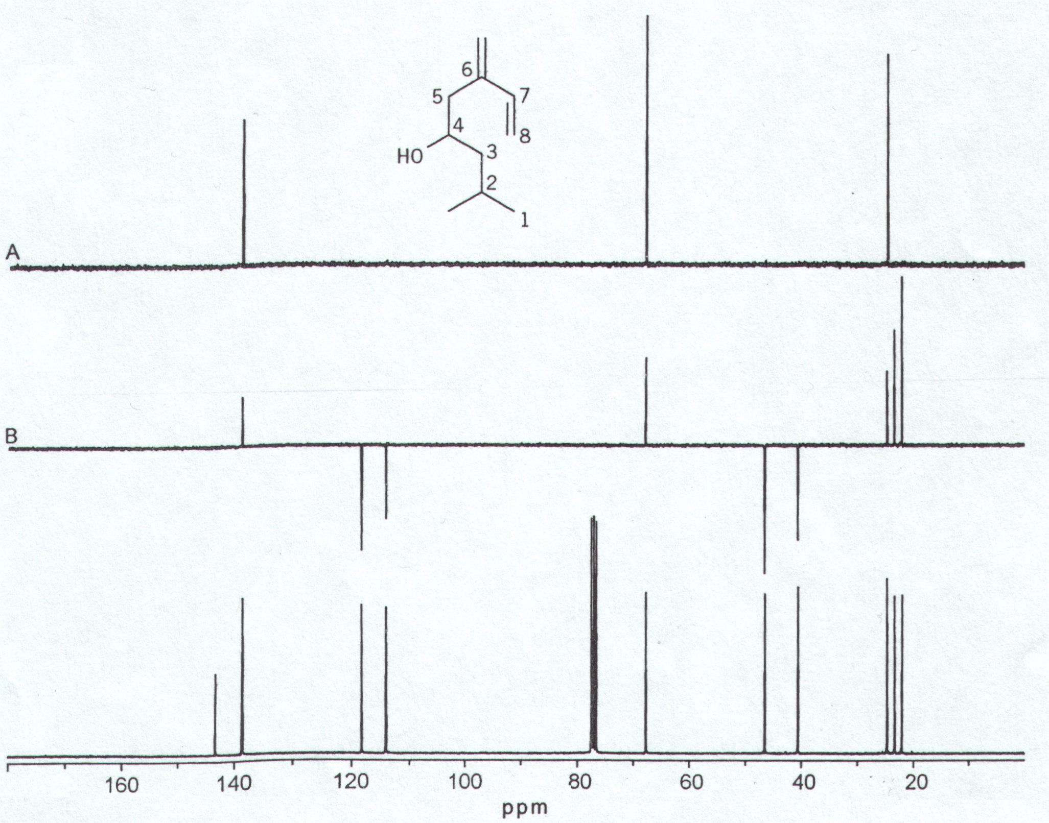
C. Interpretation of spectra

Slide 47
DEPT spectrum and its interpretation
d
c
b
a
e
(DEPT- 45)+(DEPT-135)-(DEPT- 90)
CH₃
DEPT-135(CH + CH₃ - CH₂)
(DEPT- 45)-(DEPPT-135)
CH₂
DEPT- 90 (CH)
DEPT- 90
CH
DEPT- 45 (CH + CH₂ + CH₃)
DEPT- 45
All protonated
b
c
d
e
a
¹³C spectrum
¹³C spectrum
220 200 180 160 140 120 100 80 60 40 20 0
220 200 180 160 140 120 100 80 60 40 20 0
DEPT spectra
Pure subspectra

Slide 48
Stage 1; All C’s are shown
O
CCH₂CH₂CH₂CH₃
CH
CH
CH₂
CH
CH₂
O
CH₂
CH₃
C
C
200
180
160
140
120
100
80
60
40
20
0
Chemical shift (δ, ppm)
Notes:
1

Slide 49
Stage 2
O
CCH₂CH₂CH₂CH₃
CH
CH
CH₃
CH
CH and CH₃ unaffected
C and C=O nulled
CH₂ inverted
CH₂
CH₂
CH₂
200
180
160
140
120
100
80
60
40
20
0
Chemical shift (δ, ppm)
Notes:
1

Slide 50
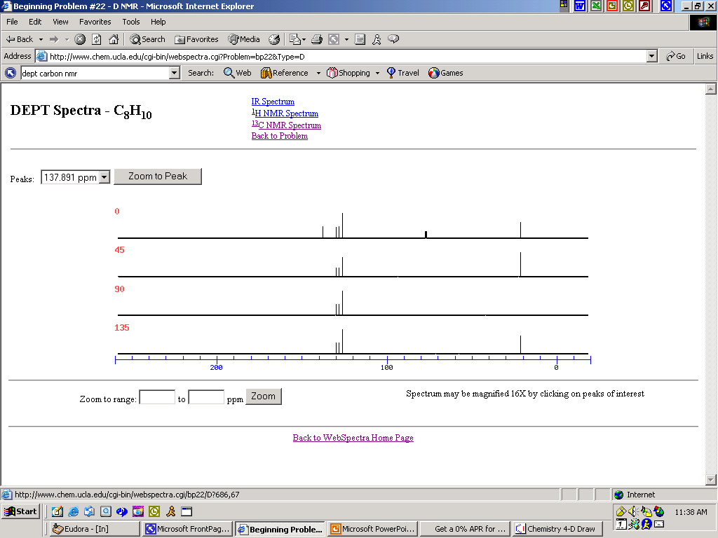

Slide 51
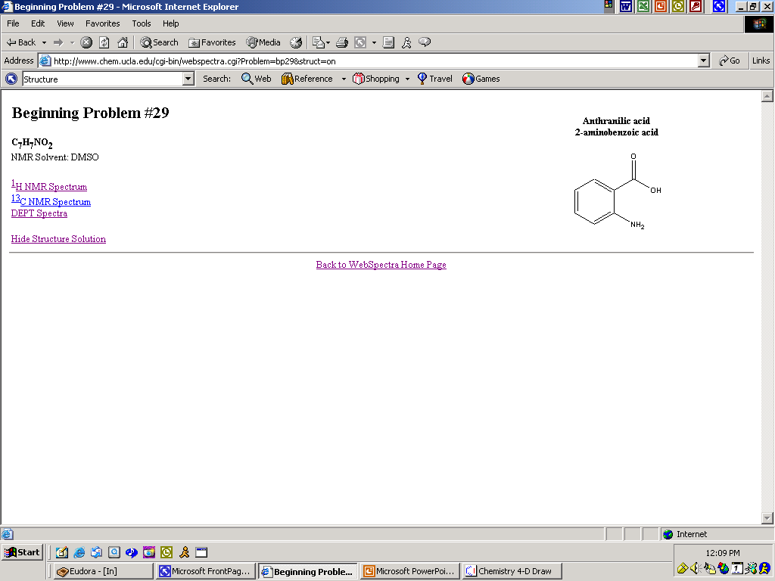
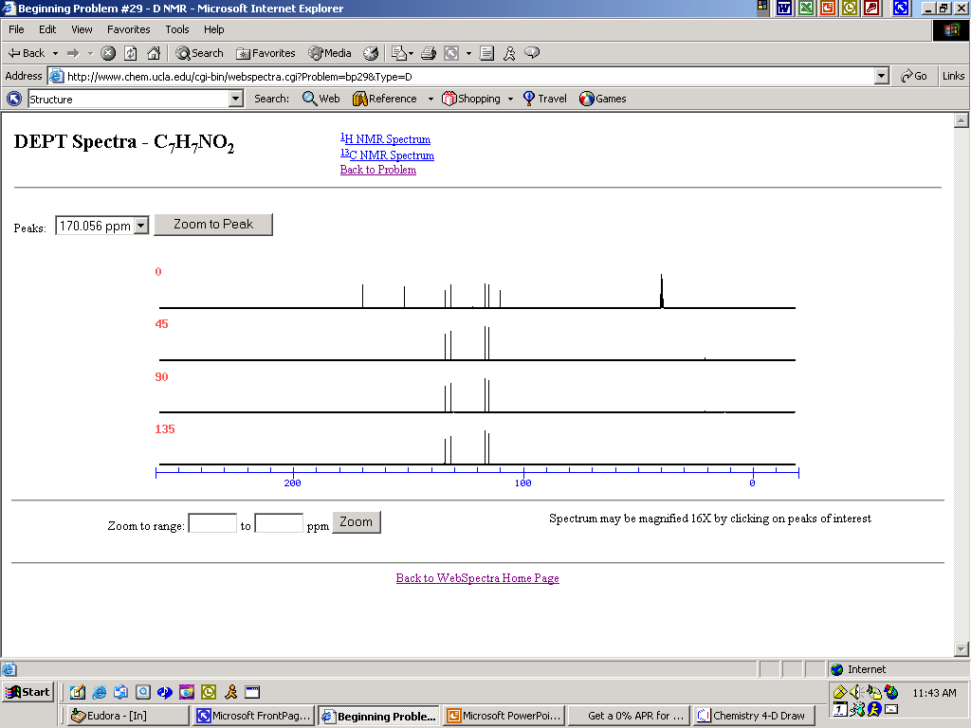

Slide 52
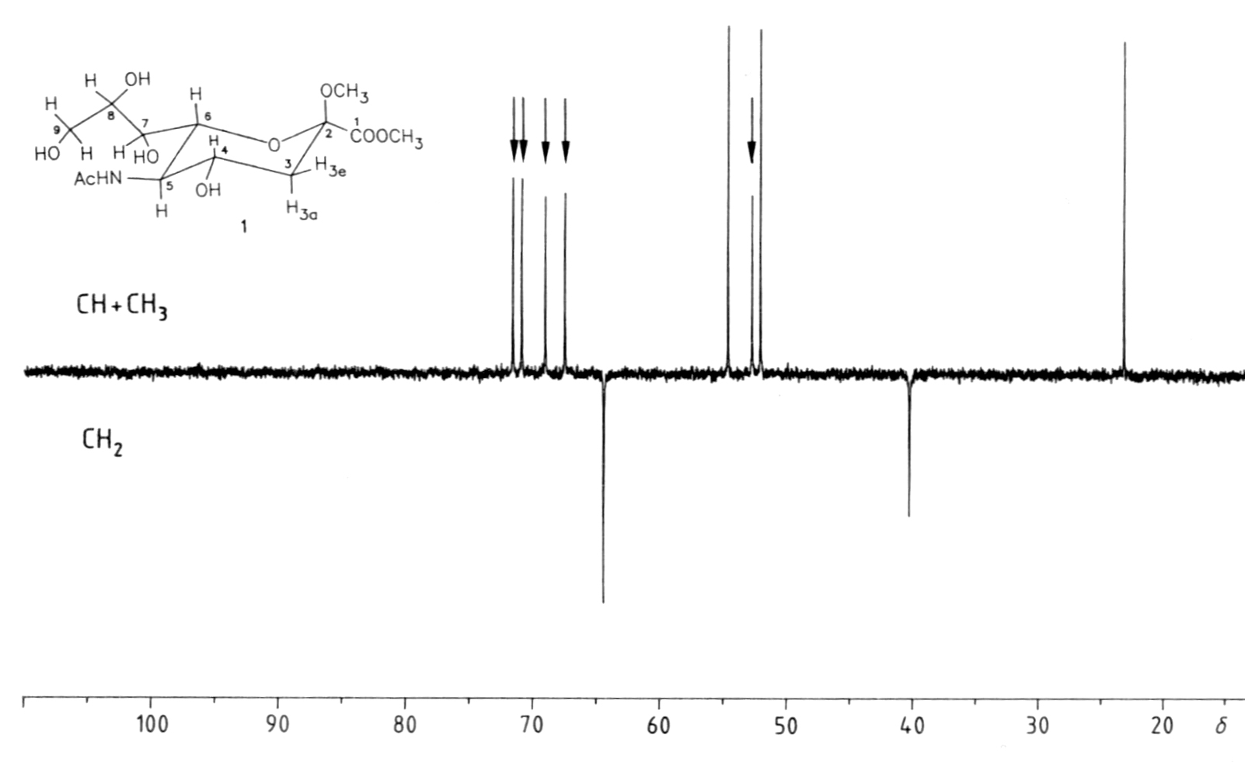

Slide 53
7. INEPt and related experiments

Slide 54
A. Definition and obtainable data
Insensitive nuclei enhanced by polarization transfer
Not better than DEPT (DEPT is more sensitive), but INEPT shows exact multiplicities
pendant
Polarization Enhancement Nurtured During Attached Nucleus Testing)
Obtained from mixing DEPT and INEPT techniques

Slide 55
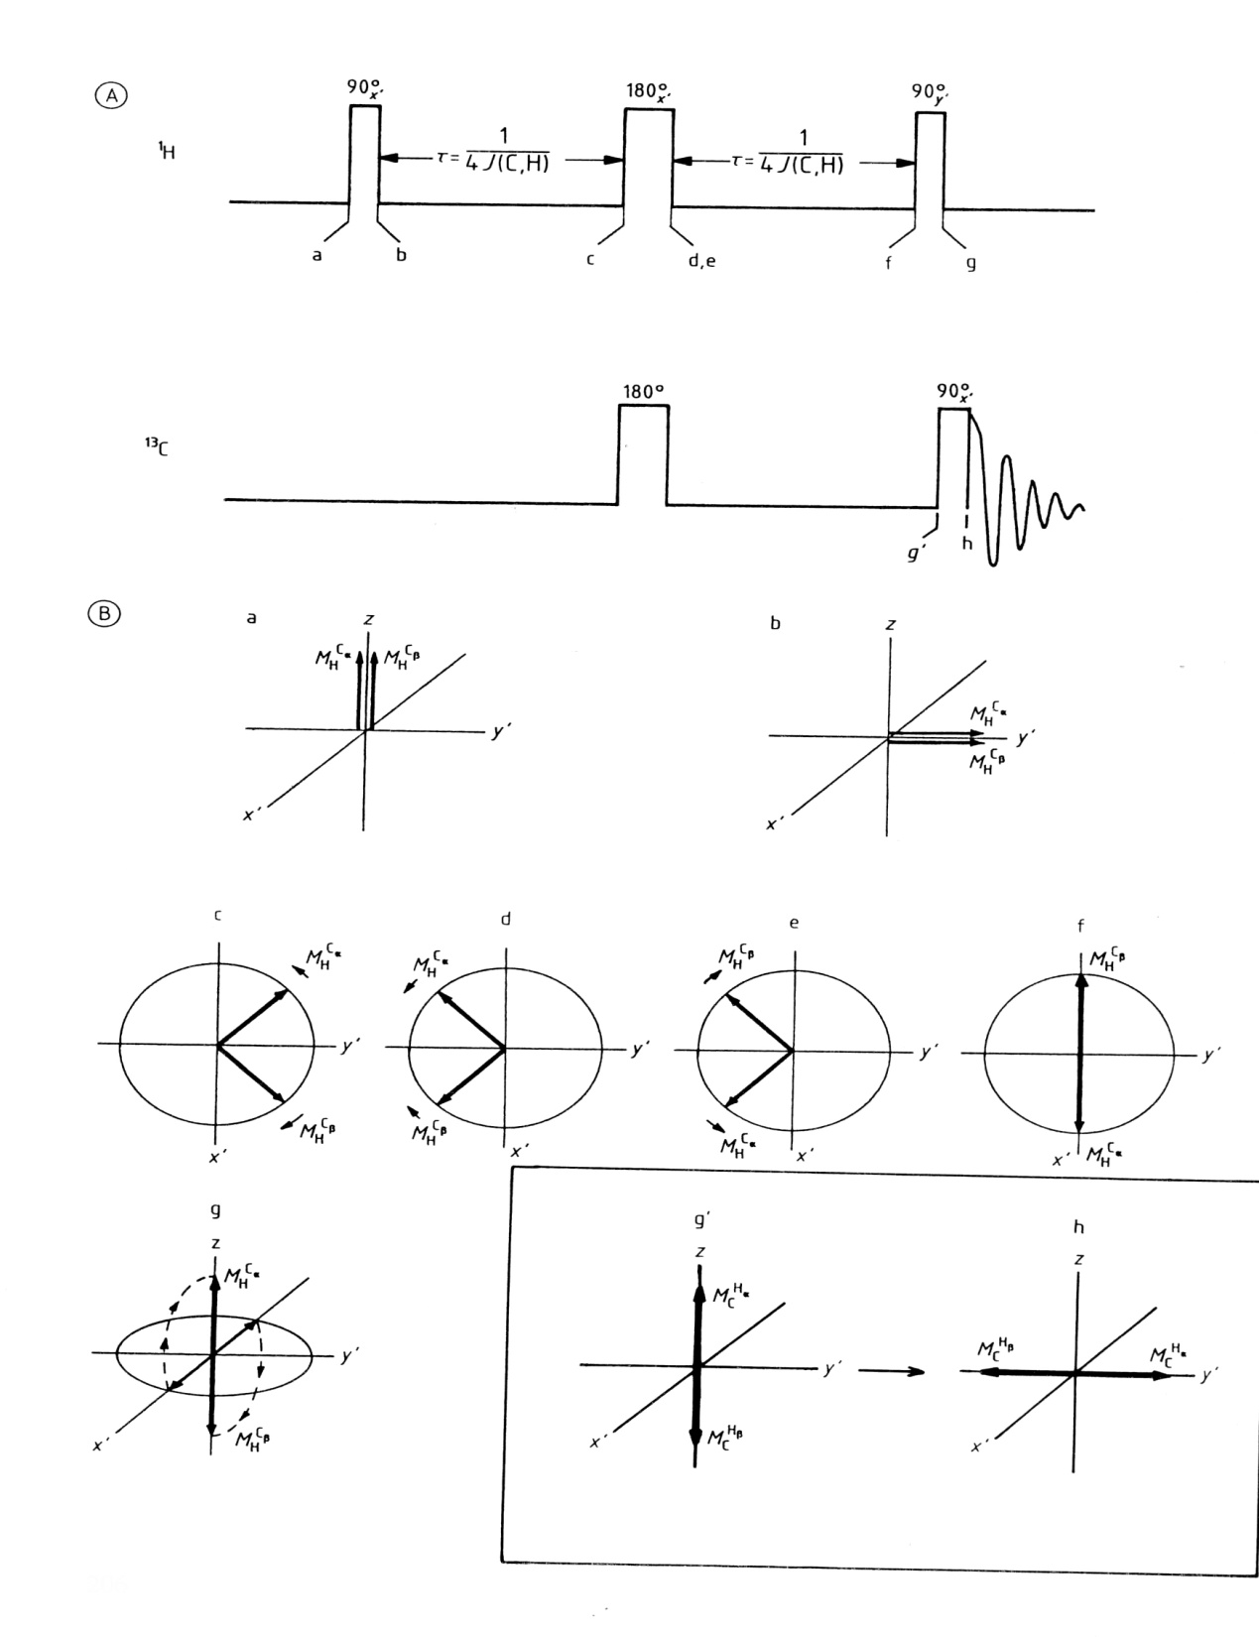
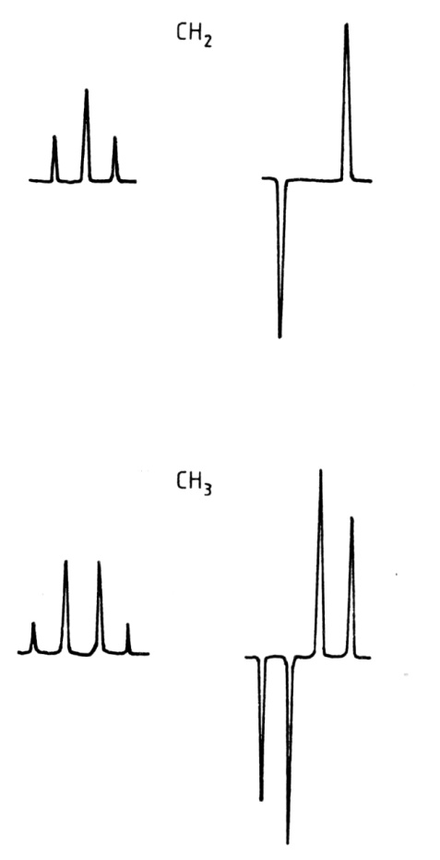
B. Pulse sequence and
C. Spectra

Slide 56
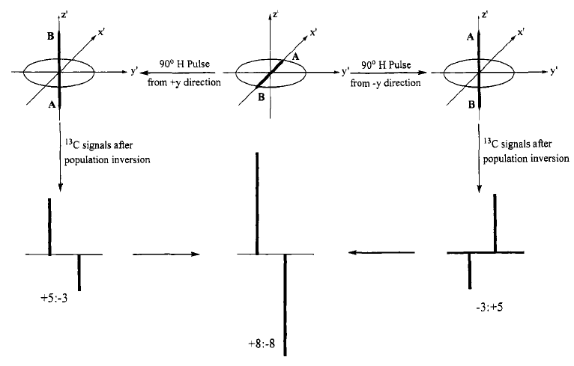

Slide 57
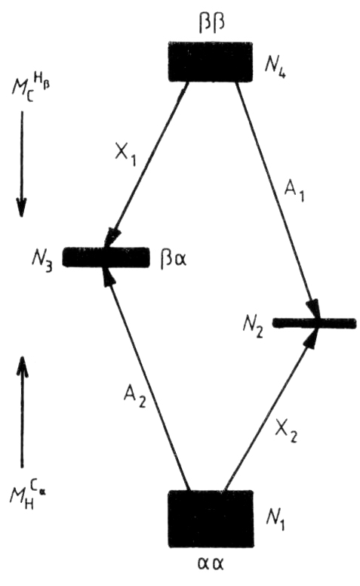
شماي سطوح انرژي براي يک سيستم دو اسپيني AX (₃CHCl¹³) در آزمايش INEPT. آزمايش جمعيت سطوح 2و 4 را معکوس مي کند که جهت هاي بردار مغناطيسي ماکروسکوپي M_{C}^{Hα} و M_{C}^{Hβ} در مقايسه با وضعيت تعادلي را معکوس می کند. در طیف C NMR¹³ همانند روش SPI دو سيگنال تقویت شده، يکي مثبت و ديگري منفي قابل مشاهده است

Slide 58
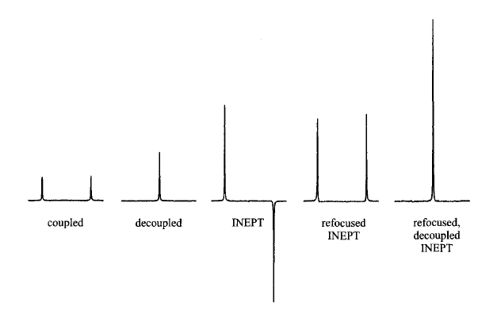

Slide 59
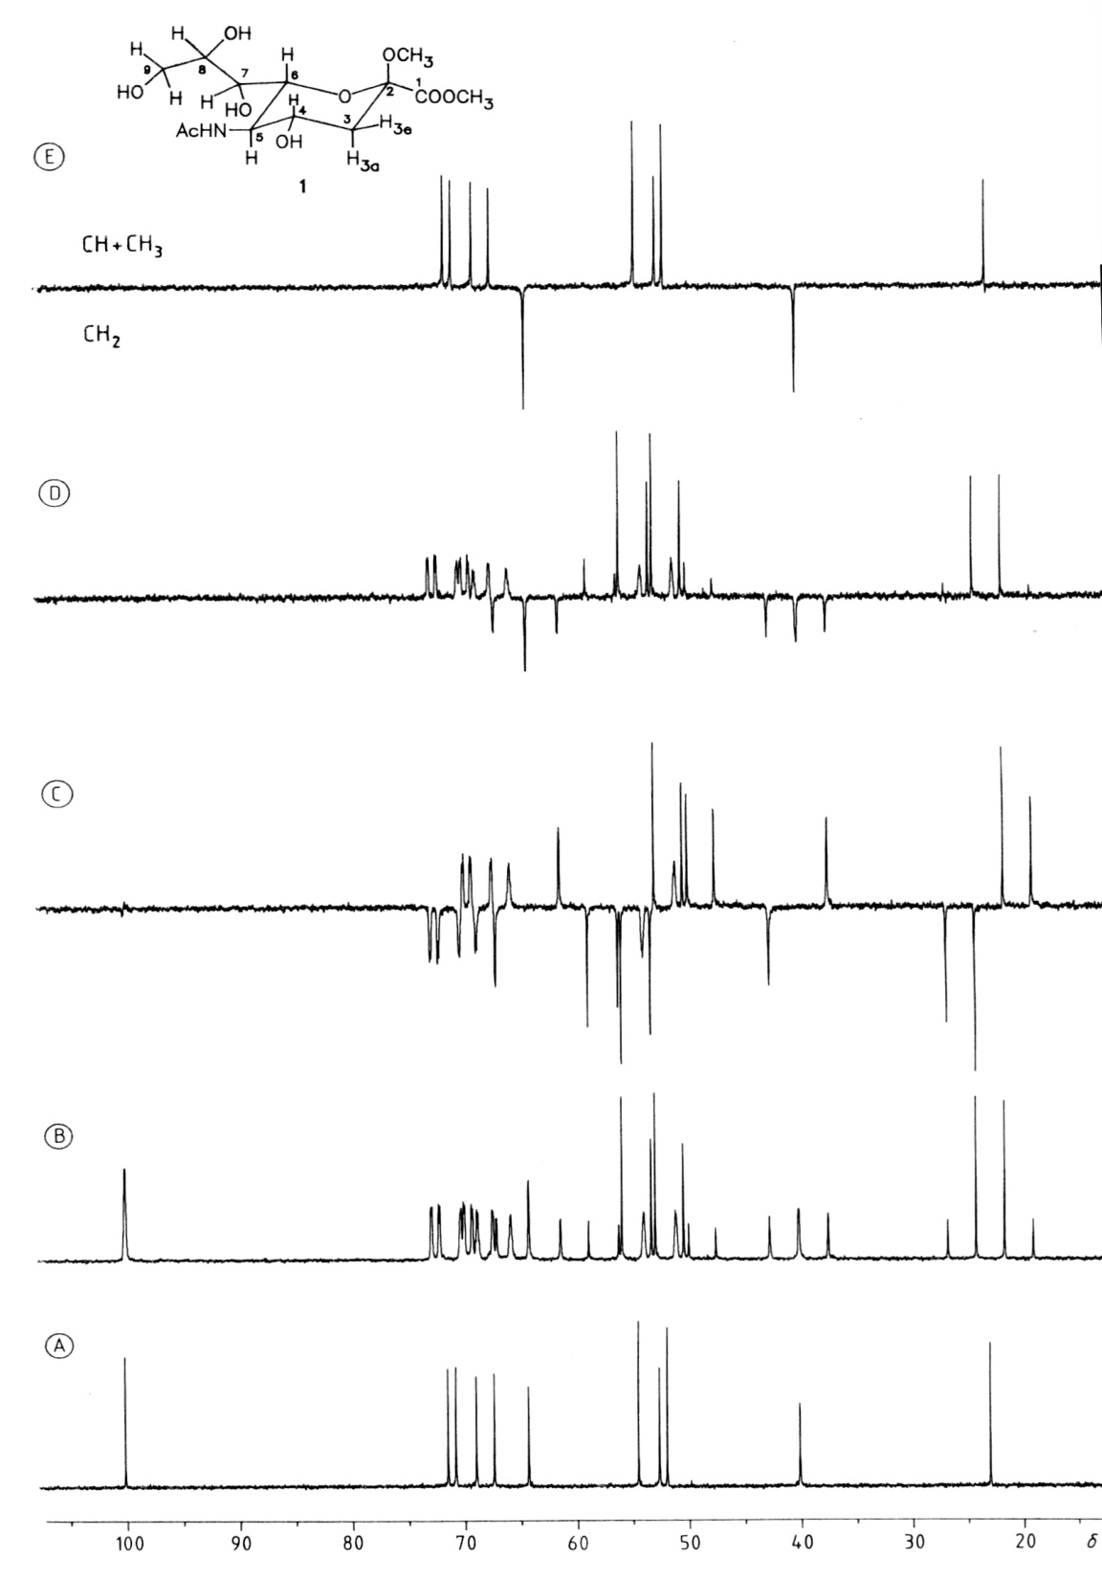
CPD
Gated
INEPT
Refocused INEPT
Refocused INEPT + BB decoupling

Slide 60
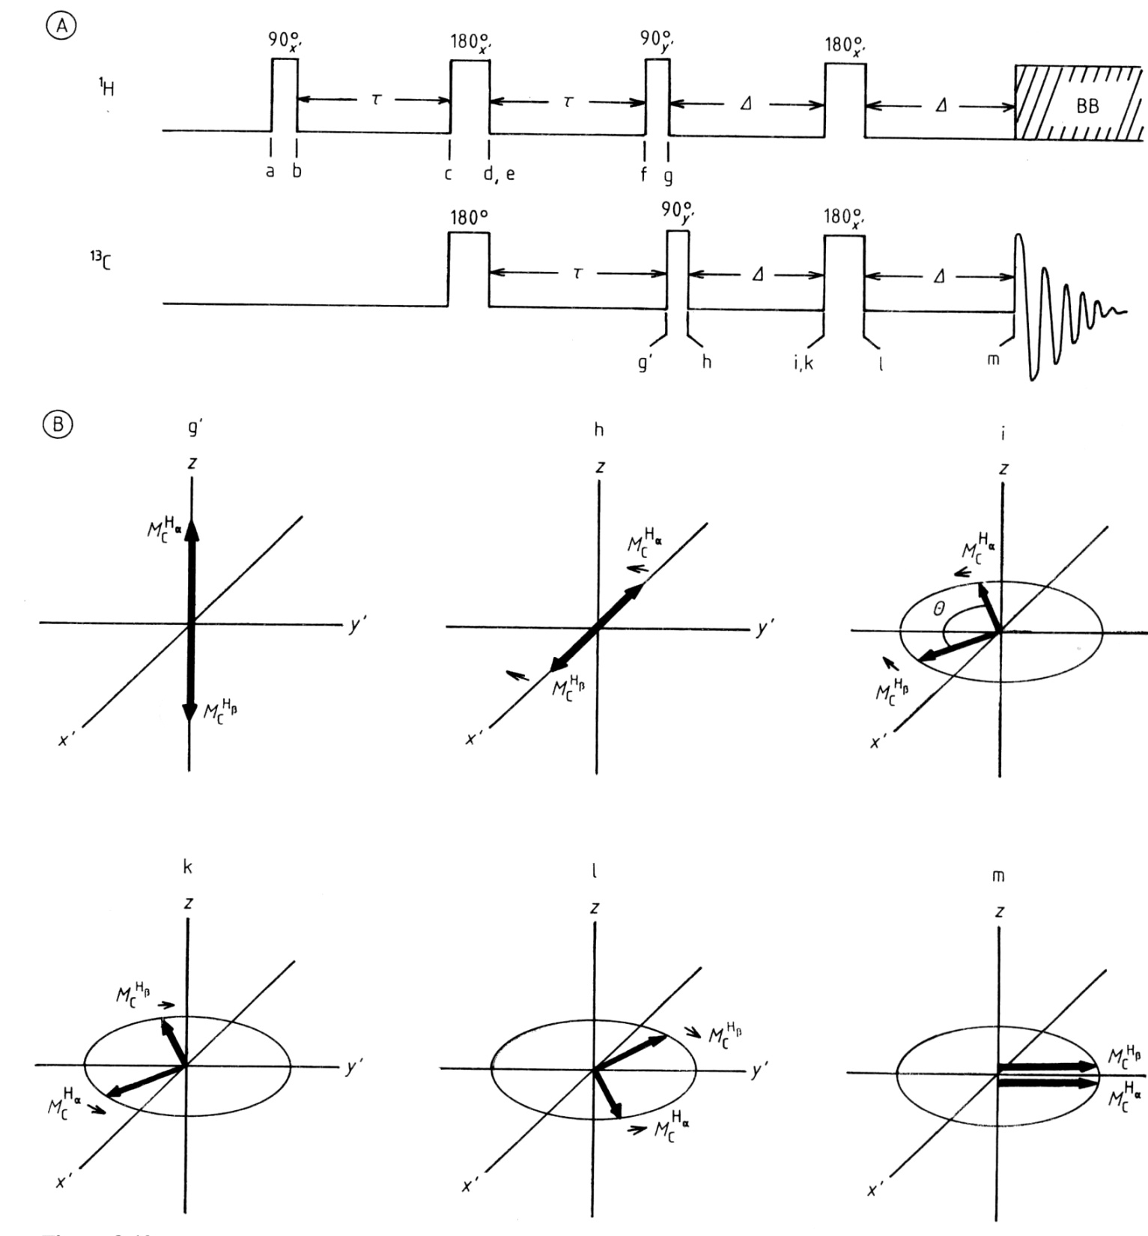
Refocused INEPT
In simple INEPT, different signs of signals may delete one signal

Slide 61
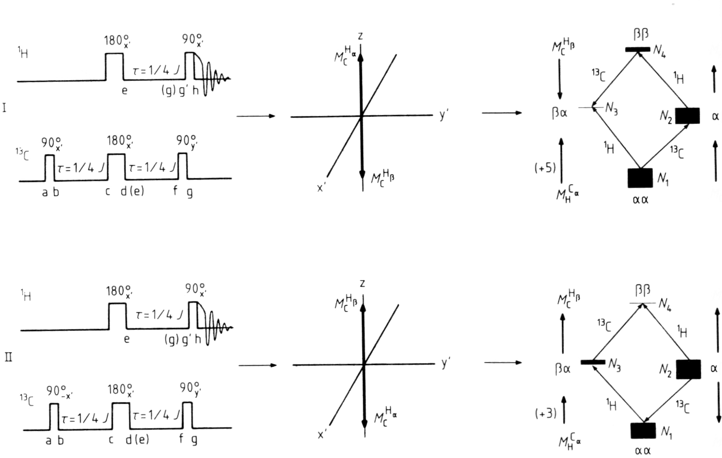
Reverse INEPT

Slide 62
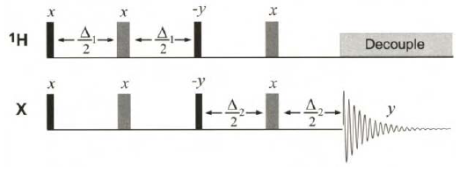
Pendant pulse sequence

Slide 63
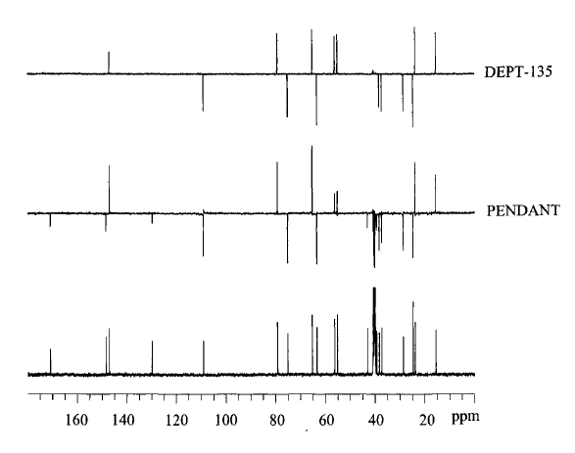

Slide 64
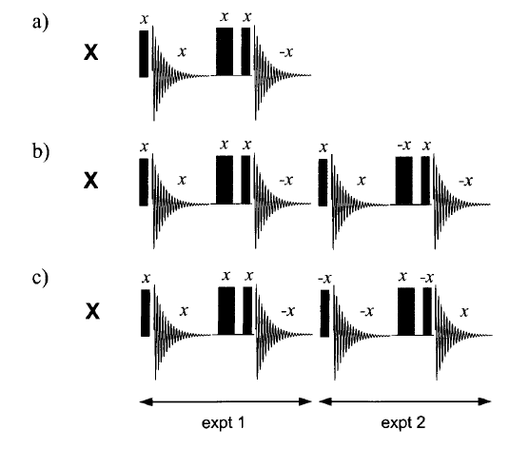
Ride and acoustic ringing
Techniques to observe quadrupolar nuclei with very broad signals

Slide 65
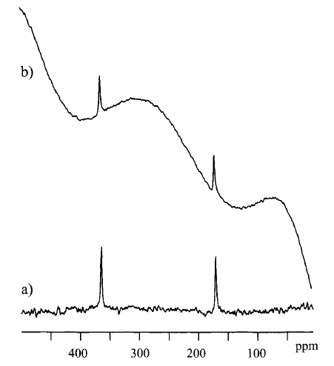
¹⁷O spectra of ethyla acetate
b. Simple
a. RIDE

Slide 66
Part b. two-dimensional
Fundamentals

Slide 67
THE BASIC IDEA OF nD NMR
For a single uncoupled proton resonance
P: Preparation
E: Evolution
M: Mixing
D: Detection
Amplitude modulation of a singlet resonance as a function of t₁
(signal decays due to spin relaxation)
FT t₂
FT t₁

Slide 68
The concept can be expanded to 3 and n dimensions
two-dimensional (2D) experiment
threedimensional (3D) experiment
In the previous slide two-dimensional experiment, a sample containing two uncoupled spins A and X, of offsets ν_{A} and ν_{X}, will produce 2D peaks at their corresponding chemical shift offsets in both dimensions (2D spectra are in fact 3D images).
Contour Plot

Slide 69
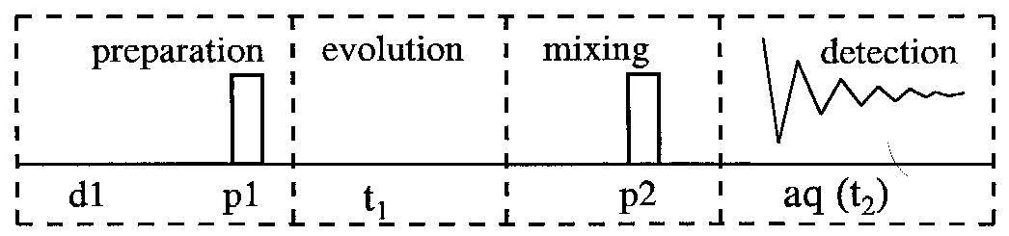
Four periods in 2D experiment
Preparation spin system relaxes and then excited by r.f.
Evolution (t1) chemical shifts & spin-spin couplings evolve. This is the timedomain which is incremented during a 2D experiment
Mixing r.f. pulses are applied and create observable transverse magnetization
Detection (t2) observable transverse magnetization is recorded. It is usually labeled with t2

Slide 70

2D NMR
Primary 2D matrix consists a series of FIDs.
A set of 1D NMR spectra is obtained by Fourier transformation with respect to t2
The signals of each transformation may differ in amplitude and phase. A second Fourier transformation with respect to t1 yields the final 2D matrix with frequency axes F₁ and F₂
1.
2.
3.

Slide 71
SENSITIVITY IN HETERONUCLEAR 2D NMR SPECTROSCOPY
The major concern for chemist is the horrible low sensitivity of NMR compared to
other spectroscopies
For experiments involving spin ½ nuclei:
N: number of molecules in the observed sample volume
A: a term that represents the abundance of the NMR-active spins involved in
the experiment,
T: temperature
B₀: the static magnetic field,
γ_{exc} and γ_{obs} represent the magnetogyric ratios of the initially excited and observed spins, respectively
T₂*: the effective transverse relaxation time
S: is the total number of accumulated scans

Slide 72
Relative Sensitivity of Different 2D Schemes
P: preparation
E: evolution
M: mixing
D: detection

Slide 73
Use of 2D NMR to Resolve Overlapping Sub-spectra in 1D
1D
Sub-spectra
overlapped
Off-diagonal
cross peaks
resolved!
2D
Coupled spins

Slide 74





2D J-resolved
COSY 45. COSY 90. COSY DQF. TOCSY.
COSY L.R. TOCSY
Relayed COSY. (with one homonuclear
relayed).
NOESY. ROESY.

Slide 75




Homonuclear Experiment: Single channel, single resonance
2D COSY (directly J-coupled)
TOCSY or HOHAHA
(Total Correlation Spectroscopy)
(directly or indirectly J-coupled)
2D NOESY (thru space d_{AB})
(NOE Spectroscopy)
2D ROESY (Rotating frame NOESY)
(thru space d_{AB})

Slide 76




Heteronuclear Experiment: Double resonance (e.g H, C)
H,C-Hetero-COSY (directly H-C J-coupled)
DEPT (Distortionless Enhancement
via Polarization Transfer)
Detecting C
Inverse experiment: magnetization is transferred back to the more
sensitive H
HSQC (Heteronuclear Single Quantum Correlation) (directly H-C J-coupled)
HMQC (Heteronuclear Multi-Quantum Correlation) (directly H-C J-coupled)

Slide 77
8. J-Resolved

Slide 78
A. Definition and obtainable data
One dimension is CNMR (or HNMR) and the other shows multiplicity of each carbon
The second axes shows type of carbon or multiplicity of hydrogen

Slide 79

B. Pulse sequence heteronuclear

Slide 80

homonuclear

Slide 81

C. Interpretation of spectra

Slide 82


Slide 83

Homonuclear

Slide 84


Slide 85



Slide 86
9. COSY (homonuclear)

Slide 87
2D-Correlation Spectroscopy (COSY)
  Through-bond Saturation transfer between J-coupled nuclear spins.
2D-Nuclear overhauser effect spectroscopy (NOESY) or 2D Rotating frame overhauser effect spectroscopy (ROESY)
  Through-space Saturation transfer between nuclear spins.
NOESY/ROESY
H
H
C
C
COSY

Slide 88
Types of cosy
COSY-90 : Correlating coupled homonuclear spins. Typically used for correlating protons coupled over two or three bonds but may be used for any high-abundance nuclide. The basic COSY experiment.
DQF-COSY :Correlating coupled homonuclear spins. Typically used for correlating protons coupled over two or three bonds. Higher-resolution
display than basic COSY. Additional information on magnitudes of coupling constants may be extracted from 2D peak fine structure. Singlets suppressed.
COSY-b : orrelating coupled homonuclear spins. Typically used for correlating protons coupled over two or three bonds but may be used for any high-abundance nuclide. Reduced 2D peak structure over basic COSY. Vicinal and geminal coupling relationships can be differentiated in some cases.
Delayed COSY : Correlating coupled homonuclear spins through small couplings. Often used to identify proton correlations over many bonds (>3), hence also known as long-range COSY.

Slide 89
COSY spectrum (COrrelation SpectroscopY)
90
90
H_{a} / H_{b}
F₁
t₁
t₂
H_{a}
FT(t₁, t₂)
cross peak
diagonal peaks
¹H
128 x 1024 (256 x 1024)
256 x 1024 (512 x 1024)
512 x 1024 (1024 x 2048)
COSY spectrum
H_{b}
F₂
¹H
H_{b}
H_{a}
1
= 0-18 Hz
⁴J_{HH}
³J_{HH}
H_{a}
²J_{HH}
= 0-30 Hz
2
t₁
3
H_{a}
H_{b}
C
H_{b}
4
t₂
C
C

Slide 90
Interpreting a ¹H-¹H COSY Spectrum
Draw a diagonal line from the lower left to upper right corner. Each contour represent carbons bond to H in the compound.
The contours not on the diagonal are called cross peaks. The connectivity information is found here.

Slide 91
COSY spectrum and its Interpretation
a
b
d
c
e
e
e
H_{e}
H_{b} / H_{c}
H_{a}
H_{b}
H_{c}
H_{d}
c
C
C
c
C
C
C
C
d
d
b
b
a
a
diagonal peak → cross peak → diagonal peak

Slide 92
COSY spectrum and its Interpretation
a
e
d
c
b
f
f
H_{a}
H_{b}
H_{c}
H_{d}
H_{f}
( )
b
C
C
C
C
C
C
H_{e}
c
d
e
a
diagonal peak → cross peak → diagonal peak

Slide 93
COSY spectrum and its Interpretation
a
d
c
b/e
f
f
H_{a}
H_{b}
H_{c}
H_{d}
H_{e}
H_{f}
( )
b/e
C
C
C
C
C
C
C
Overlapped signals
c
b c
d
b d
a
diagonal peak → cross peak → diagonal peak

Slide 94
Idealized System
H
D
Cl
H
1
4
C
C
C
C
Cl
D
C
C
H
H
2
3

Slide 95


1D-spectrum
1
2
3
4

Slide 96


2D-spectrum

Slide 97

COSY

Slide 98

COSY

Slide 99

COSY

Slide 100

Can’t Differentiate

Slide 101

Actual COSY Spectrum of Isobutanol
A
B
A, B
C
B,C

Slide 102

a
COSY Spectrum
Methyl Ethyl Ketone
c
b
c
a
b

Slide 103
a
COSY Spectrum
Methyl Ethyl Ketone
c
b
c
a
b

Slide 104
c
COSY Spectrum
Methyl Ethyl Ketone
a
b
c
a
b
connectivity

Slide 105

ii
i
iv
v
iii
v
O
CH₃CCH₂CH₂CH₂CH₃
iv
iii
i
ii

Slide 106
i
O
CH₃CCH₂CH₂CH₂CH₃
No connectivity
i

Slide 107
iii
O
CH₃CCH₂CH₂CH₂CH₃
b)
a)
ii

Slide 108
iii
iv
O
CH₃CCH₂CH₂CH₂CH₃
c)
iii
b)
a)

Slide 109
v
iv
O
e)
CH₃CCH₂CH₂CH₂CH₃
iv
c)
d)
b)
a)

Slide 110
O
f)
e)
CH₃CCH₂CH₂CH₂CH₃
c)
d)
b)
a)

Slide 111


Slide 112


Slide 113


Phase Sensitive COSY Phase Sensitive DQF-COSY*
*DQF: Double Quantum Filtered

Slide 114
Phase Sensitive DQF-COSY
Suppressed by DQF
HDO
MeOD
Antiphase Absortive Structure
1D double-quantum filtration of the spectrum of the peptide Leu-enkephalin 5.4 in CD₃OD. The singlet resonances of the solvent, truncated in the conventional 1D spectrum (a), have been filtered out in (b). The remaining peaks in (b) display the
characteristic anti-phase multiplet structure (which may be masked by magnitude calculation if desired

Slide 115
Multiplets Structure in Phase Sensitive DQF COSY
AX Spin System
AMX Spin System

Slide 116
High Resolution DQF COSY

Slide 117
COSY-β
In the COSY-β experiment, the mixing pulse is usually set to 45º or 60º
V: Vecinal J (Positive), G: Geminal J (Negative)

Slide 118
Delayed COSY: detecting small couplings
The delayed (or longrange) COSY sequence. Additional fixed delays are inserted into the basic COSY sequence to enhance the appearance of correlations from small couplings.
The small J’s (1 Hz),
COSY-90 Delayed COSY (Δ = 200ms)

Slide 119


Slide 120


COSY

Slide 121

DQF-COSY

Slide 122

y
x

Slide 123


Slide 124


Slide 125



Slide 126
10. COSY (heteronuclear:HETCOR)

Slide 127
HETCOR (Heteronuclear Correlation)
Correlating coupled heteronuclear spins across a single bond. Employs detection of the lower- nuclide, typically ¹³C, so has
significantly lower sensitivity than inverse techniques. Benefits from high resolution in ¹³C dimension, so may find use when this is critical, otherwise superseded by above methods.

Slide 128
Advantages of
Heteronuclear nD NMR
Uses a second nucleus to resolve overlap of the first: chemical shift of each nucleus is sensitive to different factors
More information to identify resonances
Less sensitive to MW because this strategy uses large 1 and 2-bond scalar couplings

Slide 129

B. Pulse sequence

Slide 130

HETCOR spectrum of 2-methyl-3-pentanone
CH₃
CH
CH₂
x
CH₃
y

Slide 131

¹³C-NMR
O
¹³C
v
CH₃CCH₂CH₂CH₂CH₃
iv
¹H
iii
¹H-NMR
i
ii
Notes:
9

Slide 132

C,H Correlation by Polarization Transfer (HETCOR)

Slide 133


Slide 134


Slide 135
11. HMQC
Related:
BIRD (Bilinear rotation decoupling)

Slide 136
A. Definition and obtainable data
HMQC (Heteronuclear Multiple Quantum Correlation)
Correlating coupled heteronuclear spins across a single bond and hence identifying directly connected nuclei, most often ¹H–¹³C.
Employs detection of high-sensitivity nuclide, e.g. ¹H, ¹⁹F, ³¹P (an ‘inverse technique’). Experimentally robust sequence, well suited to routine structural characterization.

Slide 137

B. Pulse sequence

Slide 138
Pairing ¹H and ¹³C Shifts by using the HSQC / HMQC spectrum
HMQC (Heteronuclear Multiple Quantum Correlation)
/ HSQC (Heteronuclear Single Quantum Correlation)
C_{a}
C_{b}
¹³C
¹J_{CH}
= 125-250 Hz
¹H
1/2J_{CH}
H_{a}
t₂
FT(t₁, t₂)
t₁
H_{b}
HSQC spectrum
128 x 1024 (256 x 1024)
256 x 1024 (512 x 1024)
H_{a}
H_{b}
¹H
¹J_{CH}
2
1
¹³C
¹³C
¹H
t₁
t₂
C_{a}
4
3
¹H_{a}
¹H_{b}
¹J_{CH}
¹J_{CH}
C_{b}
C_{a}
O
C_{b}

Slide 139
HMQC/HSQC spectrum and its Interpretation
H
H
O
H
H
C
C
O
C
C
H
a
b
c
d
H
H
H
c
b
d
a
CH_{3, a}
CH_{3, d}
¹H
CH_{2, b}
¹³C

Slide 140
A simulated HMQC spectrum
¹H chemical
shifts
¹³C chemical
shifts
no correlation

Slide 141


diastereotopic CH₂’s

Slide 142


Slide 143



Slide 144
12. HSQC

Slide 145
A. Definition and obtainable data
HSQC (Heteronuclear Single Quantum Correlation)
Correlating coupled heteronuclear spins across a single bond and hence identifying directly connected nuclei. Employs detection of high-sensitivity nuclide, e.g. ¹H, ¹⁹F, ³¹P (an ‘inverse technique’). Provides improved resolution over HMQC, so it is better suited for crowded spectra but can be more sensitive to experimental imperfections.

Slide 146

B. Pulse sequence

Slide 147

C. Interpretation of spectra

Slide 148


Slide 149
HMQC or HSQC?
Lets See

Slide 150
Comparison of ¹²C-¹H signal suppression methods used in proton detected heteronuclear correlation experiments
Clean
¹²C-¹H
Conventional 1D proton spectrum without suppression of the parent resonance and displays the required ¹³C satellites.
Phase cycling
Optimised BIRD presaturation
(d) Pulsed field gradients to remove the parent line (Notice loss of sensitivity)

Slide 151

Echo-Antiecho Gradient HSQC
Echo-Antiecho Gradient HSQC with Sensitivity Enhancement (PEP)
x2 Gain in
Senstitivity

Slide 152
Editing based on multiplicity

Slide 153

DEPT-HMQC
Δ = 1/2J
Edited HSQC

Slide 154


Edited HSQC
CH2 (Black)
CH and CH3 (Red)

Slide 155


HSQC: Sensitivity Enhancement with Square ¹³C 180 degree pulses
HSQC: Sensitivity Enhancement with Adiabatic ¹³C 180 degree pulses
Adiabatic Inversion
Adiabatic Refocusing

Slide 156

Hymenistatin

Slide 157


Slide 158


Slide 159
Heteronuclear Multiple-Bond Correlation Spectroscopy (HMBC)
HMBC is in principle an HMQC experiment tuned for small ¹H-¹³C coupling constants

Slide 161

Magnitude Mode HMBC
with low-pass filter
12a
12b
C7
One-Bond
Cross-Peak
C11
Ludartin
C13

Slide 162
13. HMBC

Slide 163
A. Definition and obtainable data
The HMBC experiment suppresses correlations via ¹J_{C,H} while ²J, ³J can be conserved.
HMBC (Heteronuclear Multiple Bonds Correlation)
Correlating coupled spins across multiple bonds. Employs detection of high-sensitivity nuclide, e.g. ¹H, ¹⁹F, ³¹P (an ‘inverse technique’). Essentially HMQC tuned for the detection of small couplings. Most valuable in correlating ¹H–¹³C over two or three bonds. Powerful tool for linking together structural fragments.

Slide 164
This is a 2D experiment used to correlate, or connect, ¹H and ¹³C peaks for atoms separated by multiple bonds (usually 2 or 3).
The coordinates of each peak seen in the contour plot are the ¹H and ¹³C chemical shifts. This is extremely useful for making assignments and mapping out covalent structure.
Points
Heteronuclear Multiple Bond Correlation
¹³C-¹H Correlations over Several Bonds
Typically over 2 or 3 bonds can be seen.
Possible because of sensitivity of the powerful magnets of today's NMR spectrometers.
Can be used to establish connectivity across barriers such as O atoms or quaternary carbon atoms

Slide 165

B. Pulse sequence

Slide 166


Assignment of Nonprotonated ¹³C’s on the basis of the HMBC spectrum
HMBC (Heteronuclear Multiple Bond Correlation)
90
180
1/2J_{CH}
t₂
1/2^{n}J_{CH}
t₁
FT(t₁, t₂)
HMBC spectrum
128 x 1024 (256 x 1024)
256 x 1024 (512 x 1024)

Slide 167


H-8
H-9
C-2
C-3
C-4
C-6
C-1
H-8 to aromatic carbons C-1
and C-6 ( both are three bond
coupling
H-9 to aromatic carbons C-1,
C-3 and C-4 ( both are three
bond coupling

Slide 168
HMBC spectrum and its Interpretation
H_{a}
H_{b}
O
H_{d}
H_{a}
C_{a}
C_{b}
O
C_{c}
C_{d}
H_{d}
H_{a}
H_{b}
H_{d}
c
b
d
a
a
d
¹H
b
¹³C

Slide 169


Slide 170



Slide 171


Slide 172
14. TOCSY (HOHAHA) related: coloc
(Correlation through long range coupling)

Slide 173
A. Definition and obtainable data
Total correlation spectroscopy
Homonulclear Hartmann-Hahn Spectroscopy
Correlating coupled homonuclear spins and those that reside within the same spin system but which may not share mutual couplings. Employs the propagation of magnetization along a continuous chain of spins. Powerful technique for analyzing complex proton spectra.

Slide 174


B. Pulse sequence

Slide 175
TOCSY (TOtal Correlation SpectroscopY)
90
d b c a
Mixing pulse
60~80ms
t₁
t₂
a
c
b
d
FT(t₁, t₂)
TOCSY spectrum
128 x 1024 (256 x 1024)
256 x 1024 (512 x 1024)
512 x 1024 (1024 x 2048)
3
1
³J_{HH}
³J_{HH}
³J_{HH}
H_{a}
H_{b}
H_{c}
H_{d}
4
t₁
t₂
2
C
C
C
C

Slide 176
TOCSY spectrum and its Interpretation
a
d
c
b/e
f
f
f
H_{a}
H_{b}
H_{c}
H_{d}
H_{e}
H_{f}
b/e
C
C
C
b/e
C
C
C
C
c
c
d
d
a
a

Slide 177


Sample: Chentobiose
Solvent: CDCl3
Spectrometer: AVANCE 400
Probehead: Inverse Broadband with z-Gradients
TOCSY
B
A
1
1
A Anomeric H
B Anomeric H
B ¹H NMR
A ¹H NMR
http://rmn.iqfr.csic.es/guide/tutorials/specdata/spectra/dis_tocsy.html

Slide 178




COSY & TOCSY

Slide 179

TOCSY of strychnine

Slide 180
15. NOESY, ROESY
Related:
EXSY

Slide 181


Slide 182


Slide 183
A. Definition and obtainable data
NOESY: Nuclear overhauser effect spectroscopy
ROESY: Rotating frame overhauser effect spectroscopy
A proton that is close in space to the irradiated proton is affected by the NOE whether or not it is coupled to the irradiated proton; if it is coupled, it remains at least partially coupled because the irradiation is week in comparison with that used for a decoupling experiment.
NOESY for very large molecules, ROESY for mid-size molecules
These spectra are used to locate protons that are close together in space
Can be a 1D or 2D NOESY technique
NOE is a through space effect
It has nothing to do with connectivity in the molecule

Slide 184

B. Pulse sequence
90
90
90
NOESY
t₁
Mixing pulse
200 ms
t₂
90
Mixing pulse
350 ms
FT(t₁, t₂)
ROESY
t₁
t₂
NOESY/ROESY
spectrum
NOE
NOE
t₂
H_{a}
H_{b}
H_{c}
t₁
C
C
C
NOE
diagonal peak → cross peak → diagonal peak
a
b
²J_{HH}
NOE / COSY
c

Slide 185
Nuclear Overhauser Enhancement
+45%
Which methyl signal belongs
to which group?
+18%
+17%
- 2%
- 4%
semiclathrate
Dimethylformamide
3-methylcrotonic
acid
two Me groups are non-
equivalent owing to hindered
rotation about the C-N bond.
Both Me signals are therefore found
At δ 2.79 and δ 2.94, together with a singlet
at δ 8.0 for the formyl proton. If one now saturates the Me signal at δ 2.94, the intensity of the formyl proton signal increases by 18%. When instead the other methyl signal is saturated, a decrease of 2% is observed.

Slide 186
readily
available
natural product
2
3
1
NOE difference spectrometry determined the substitution pattern of a
natural product, whose structure was either 1 or 2.
NOE difference spectrometry of compound 3 will help us to
settle the final structure

Slide 187

3
Irradiation of the 5-Me group resulted in enhancement of both H-4 and H-6,
whereas irradiation of the 3-Me group enhanced only H-4; the assignments of
these entities to the absorption peaks is now clear.

Slide 188


Slide 189


Slide 190
What if your small molecule is ~1000 Daltons?
No NOE or weak NOE

Slide 191

NOE and Molecular Weight
~1000 Daltons
0.5
NOE
0
-1
Molecular Weight

Slide 192

ROE and Molecular Weight
1
0.5
ROE
positive for all values of MW
0
Molecular Weight

Slide 193
Through space peaks
In red are negative amplitude.
(-)
(-)

Slide 194

NOESY of strychnine

Slide 195


Slide 196
16. INADEQUATE

Slide 197
Incredible natural abundance double-quantum transfer experiment
A. Definition and obtainable data
Correlating coupled homonuclear spins of low natural abundance. Typically used for correlating adjacent carbon centers at natural abundance but has extremely low sensitivity.

Slide 198

B. Pulse sequence

Slide 199


Slide 200


Slide 201


Slide 202


Slide 203
Glossary

Slide 204


Slide 205



Slide 206
I . Assignment of Resonances to Atoms Within a Molecule
Assigning ¹H Resonances on the basis of Chemical Shifts
Assigning ¹H Resonances on the basis of the COSY spectrum
Assigning ¹³C Resonances on the basis of Chemical Shifts
Pairing ¹H and ¹³C Shifts by using the HSQC / HMQC spectrum
Assignment of Nonprotonated ¹³C’s on the basis of the HMBC spectrum
Determining Stereochemistry by using the NOESY / ROESY spectrum

Slide 207
II. Elucidation of Unknown Molecular Structures
Initial Inspection of the one-dimensional spectra : ¹H and ¹³C
Pairing ¹H and ¹³C Shifts by using the HSQC / HMQC spectrum
List the¹H -¹³C data in tabular form
Establishment of connectivity between protons on the basis of the gCOSY spectrum
Assignment of Nonprotonated ¹³C’s on the basis of the HMBC spectrum
Determining Stereochemistry by using the NOESY / ROESY spectrum

Slide 208
Problems

Slide 209

Problem 1
C₉H₉ClO₂
MW=184.62
¹H NMR
* Problem 1 and 2 are selected from “Organic Structure Determination Using 2-D NMR Spectroscopy” - J. H. Simpson, 2008

Slide 210

¹³C NMR
The carbon signal at 157.0 ppm is lost

Slide 211

HMQC

Slide 212
¹H COSY

Slide 213
NOESY

Slide 214

Problem 2
¹H NMR
C₇H₁₂O₂

Slide 215

¹³C NMR

Slide 216

HSQC

Slide 217
¹H COSY

Slide 218
HMBC

Slide 219

Problem 3
¹H spectrum
2.33
2.26
3.64
7.37
(d, 8.0)
7.24
(dd, 8.0, 7.4)
8.06
(d, 7.7)
10.8
7.04
(dd, 7.7, 7.4)

Slide 220


¹³C spectrum
142.6
139.5
138.3
136.9
127.0
123.8
122.8
121.9
118.0
110.2
108.5
109.6
13.4
12.5
60.6
x
x
x

Slide 221
HSQC

Slide 222
COSY Spectrum
8.06
7.37
7.24
7.04

Slide 223
HMBC Spectrum

Slide 224
Expanded HMBC Spectrum
108.5
138.3
136.9
127.0

Slide 225
Expanded HMBC Spectrum
139.5
123.8
121.9
118.0
110.2
122.8

Slide 226
Expanded HMBC Spectrum
139.5
136.9
122.8
109.6

Slide 227
Problem 1
C₉H₉ClO₂
MW=184.62
Degrees of unsaturation = 9 – 9/2 + 1-1/2 =10
¹H NMR
6.85
7.22
2.90
2.75
4.20
3.90
3.34

Slide 228
¹³C NMR
* The carbon signal at 157.0 ppm is lost

Slide 229
HMQC
129.4
115.9
69.0
50.0
44.6
2.75
2.90
3.34
3.90
4.20
129.4 - 7.22
115.9 – 6.85
69.0 – 3.90 / 4.20
50.0 – 3.34
44.6 – 2.75 / 2.90
6.85
7.22

Slide 230
¹H COSY
129.4 - 7.22
115.9 – 6.85
69.0 – 3.90 / 4.20
50.0 – 3.34
44.6 – 2.75 / 2.90
3.90
4.20
2.75
2.90
3.34
7.22
X
6.85

Slide 231
NOESY
C₉H₉ClO₂
C₉H₉ClO₂
7.22
C₉H₉ClO₂
6.85
3.90
4.20
2.75
2.90
3.34

Slide 232
Problem 2
¹H NMR
C₇H₁₂O₂
Degrees of unsaturation = 7 – 12/2 + 1 =2
1.16
4.90
1.76
6.15
3.79
3.50
4.68
2.07
1.86

Slide 233
¹³C NMR

Slide 234
HSQC
26.8
140.4
101.1
96.7
63.5
16.3
15.0
1.16
1.76
1.86
2.07
3.50
3.79
140.4 – 6.15
101.1 – 4.68
96.7 – 4.90
63.5 – 3.50 / 3.79
26.8 – 1.76 (CH₂)
16.3 – 1.86 /2.07
15.0 – 1.16 (CH₃)
4.68
4.90
6.15

Slide 235
¹H COSY
1.16
1.76
1.86
2.07
140.4 – 6.15
101.1 – 4.68
96.7 – 4.90
63.5 – 3.50 / 3.79
26.8 – 1.76 (CH₂)
16.3 – 1.86 / 2.07
15.0 – 1.16 (CH₃)
3.50
3.79
4.68
4.90
1.86
2.07
3.50
3.79
4.90
1.16
1.76
6.15
6.15
4.68

Slide 236
HMBC
1.86
2.07
3.50
3.79
4.90
C₇H₁₂O₂
1.16
1.76
Degrees of unsaturation = 2
6.15
4.68
140.4 – 6.15
101.1 – 4.68
96.7 – 4.90
63.5 – 3.50 / 3.79
26.8 – 1.76 (CH₂)
16.3 – 1.86 / 2.07
15.0 – 1.16 (CH₃)

Slide 237
Problem
¹H spectrum
MW = 241
C₁₅H₁₅NO₂
Degrees of unsaturation = 15 -15/2 + 1 +1/2 = 9
2.33
2.26
3.64
7.37
(d, 8.0)
7.24
(dd, 8.0, 7.4)
8.06
(d, 7.7)
10.8
7.04
(dd, 7.7, 7.4)

Slide 238
¹³C spectrum
142.6
139.5
138.3
136.9
127.0
123.8
122.8
121.9
118.0
110.2
108.5
109.6
13.4
12.5
60.6
x
x
x

Slide 239
HSQC Spectrum
142.6
139.5
138.3
136.9
127.0
123.8 - 7.24
122.8
121.9 - 8.06
118.0 - 7.04
110.2 - 7.37
109.6
108.5
60.6 - 3.64 (CH₃)
13.4 - 2.33 (CH₃)
12.5 - 2.26 (CH₃)

Slide 240
COSY Spectrum
8.06
7.37
7.24
7.04
7.37
7.24
7.04
8.06

Slide 241
HMBC Spectrum

Slide 242
Expanded HMBC Spectrum
108.5
138.3
136.9
127.0
142.6
139.5
138.3
136.9
127.0
123.8 - 7.24
122.8
121.9 - 8.06
118.0 - 7.04
110.2 - 7.37
109.6
108.5
60.6 - 3.64 (CH₃)
13.4 - 2.33 (CH₃)
12.5 - 2.26 (CH₃)
138.3
136.9
108.5
127.0

Slide 243
Expanded HMBC Spectrum
139.5
123.8
122.8
121.9
118.0
110.2
7.04
7.24
7.37
8.06
7.37 / 110.2
7.24 / 123.8
139.5
122.8
7.04 /118.0
8.06 / 121.9

Slide 244
Expanded HMBC Spectrum
139.5
136.9
122.8
109.6
10.2
C₁₅H₁₅NO₂
Degrees of unsaturation = 9
139.5
109.5
122.8
136.9
N
H
10.2

Slide 245
MW = 241
C₁₅H₁₅NO₂

Slide 246
3D-NMR for amino acid assignment
Allows for Identification of adjacent amino acids.
Has been used for high through put assignment of amino acid sequence.

Slide 247

HNCO
Correlation between amides and carbonyls.

Slide 248

HN(CA)CO
Correlations between adjacent carbonyls.

Slide 249

HNCA
Correlation between adjacent C¹³’s

Slide 250
Step 2: Find NOE constraints
Typically, use 3D-NMR.
  Example: HSQC-NOESY
NOE’s can be ambigious
Subjective distance assignment
  Weak NOE = 3.5-5.0 Angstroms
  Medium NOE = 3-3.5 Angstroms
  Strong NOE = 0-3 Angstroms

Slide 251

3D-NMR with NOE example
(Nobel Lecture, Wütrich, 2002)

Slide 252

Step 3: MD simulation with NOE constraints
NOE distances are used to constrain the MD simulation.
After 2-3 years work,
you get a Biochemistry paper.

